Slide 1
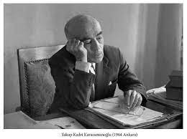
Yakup Kadri Karaosmanoğlu

Slide 2
introduction
First of all, hello, today I will introduce Yakup Kadri KARAOSMANOĞLU, who has a tremendous place in Turkish literature. In addition to the books he wrote himself, he draws attention with his being intertwined with the public and being among the people. Yakup Kadri, who fought with Atatürk during the national struggle, will enter politics after this period. if we get to know him better ;

Slide 3
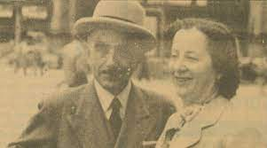
biography
Yakup Kadri Karaosmanoğlu, was born in Cairo on 27 March 1889. He was the son of Abdülkadir Bey, a member of the Karaosmanoğlu family which started to gain a reputation in the 17th century around the Manisa region. His mother was İkbal Hanım, a woman in İsmail Paşa's palace community. Until the age of six, he was raised in Cairo, after which his family moved to their homeland, Manisa. He completed his primary education in Manisa, and in 1903, the family moved to İzmir.

Slide 4
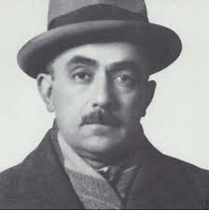
Biograph
Karaosmanoğlu was one of the contributors of İkdam during the Turkish War of Independence and after the establishment of the Republic of Turkey in 1923, a representative of Manisa to the Grand National Assembly from 1931 to 1934. Karaosmanoğlu was the founding editor-in-chief of Tan newspaper which was launched in 1935 and served in the post until 1938.^{[2]} Then until 1955, he served as an ambassador of Turkey in various European and Middle Eastern capitals

Slide 5
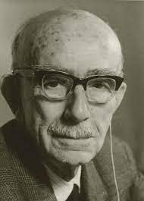
biograph
Following his return to Turkey, he served as the editor of Ulus in 1957. In 1961, he was a representative of the constituent assembly of the National Unity Committee following the 1960 coup d'état. His last political position was again as a representative of Manisa to the Grand National Assembly from 1961 to 1965. In 1966, he was elected chairman of the Anadolu Agency.
Yakup Kadri Karaosmanoğlu died at the Gülhane Military Medical Academy in Ankara on 13 December 1974. He was buried next to his mother's tomb in Yahya Efendi Cemetery [tr] in Istanbul.^{[1]}

Slide 6
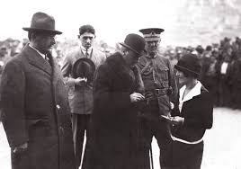
works
Yakup Kadri's first work was published in 1913. His novel Yaban (Stranger, 1932) depicts the bitter experiences of a Turkish intellectual, Ahmet Celal, in the countryside after losing his arm in the Battle of Gallipoli. Though categorized as naturalist, the novel has a romantic, anti-pastoral quality.
His novel Panorama analyzes the political, social, and economical changes during the transition period from the Ottoman Empire to the modern Republic of Turkey. It is considered to be a "generation novel" as the story is based on the lives of several generations of the same family during this transitional period.

Slide 7
bibliography
Bibliography
"Bir Serencam" (An Event or Result) (1913)
"Kiralık Konak" (The Rented Mansion) (1922)
"Nur Baba" (Baba Nur) (1922)
"Rahmet" (Mercy) (1923)
"Hüküm Gecesi" (Night of Verdict) (1927)
"Sodom ve Gomore" (Sodom and Gomorrah) (1928)
"Yaban" (A Wild One) (1932)
"Ankara" (1934)
"Ahmet Haşim" (1934)
"Bir Sürgün" (An Exile ) (1937)
"Atatürk" (1946)
"Panorama 1" (1950)

Slide 8
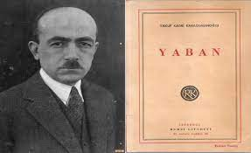
Most famous work “yaban’’
A village in Central Anatolia during the National Struggle. Ahmet Celal, who carries the extensions of the socio-psychological characteristics of the Tanzimat intellectual. Typical intellectual who sees himself as a savior, who has made it his duty to educate (or dedicate) the people, and become "alien" as a result of the conflict between the reality he has created in his mind and the reality he has experienced.

Slide 9
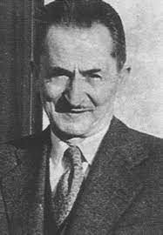
Novel summery
Ahmet Celal, who participated in the First World War as a reserve officer, returns by losing one arm in this war. When Istanbul was occupied, he obeyed the invitation of his command, Mehmet Ali, and went to his village on the shore of Porsuk Stream. But his mind is on the ongoing war. In the village, he monitors the developments by bringing a newspaper every day. Whenever he gets the chance, he tells the villagers the importance of the developments.

Slide 10
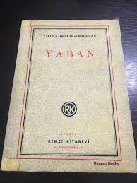
Novel summery
The people of the village depend on Salih Ağa, who is the main reason for their poverty and ignorance. Whatever he says, they believe him. No one approaches Ahmet Celal under the influence of Salih Ağa. The villager describes him as "wild". Saddened by this situation, the young officer falls into depression, and one day when he is thoroughly depressed, he goes for a walk, to get some air; He meets Emine and takes an interest in her. However, Emine is the wife of Mehmet Ali's brother İsmail. Days pass. The village is occupied. The enemies burn the village down, torture the villagers. Most of the villagers are killed en masse in the village square.

Slide 11
Novel summery
Ahmet Celal wants to escape from this circle of death with Emine. They are shot from behind, both of them injured. They reach the village cemetery with difficulty. They wait there until morning. They will leave the next day. But Emine is not in a condition to walk because her wound is severe. Ahmet Celal puts the diary in Emine's hand and goes in an unknown direction. Upon the withdrawal of the enemy armies from that region after the Battle of Sakarya (1921), the research committee that came to the village to investigate the enemy's cruelty found a notebook among the ruins and charred human bones. This is the notebook he handed over to .

