Slide 1
Sabahattin Ali
Öykü naz gökçe Reyyan kılavuz
was a Turkish novelist, short-story writer, poet, and journalist

Slide 2
Who is Sabahattin Ali?
He was born in 1907 in Eğridere township in the Ottoman Empire. His father was an Ottoman officer, Selahattin Ali, and his mother Husniye. His father's family was from the Black Sea region. He lived in Istanbul, Çanakkale and Edremit before he entered the Teacher School in Balıkesir. His elementary and middle school education was interrupted by WWI, contributing to his difficult childhood. Then he was transferred from Balikesir to the School of Education in Istanbul, where he graduated in 1926 with a teacher's certificate.
His various poems and short stories were published in the school’s student paper. After serving as a teacher in Yozgat for one year, he earned a fellowship from the Ministry of National Education and studied in Potsdam, Germany from 1928 to 1930. When he returned to Türkiye, he taught German language in high schools at Aydın and Konya.

Slide 3
Death
He suffered financial troubles. His application for a passport was denied. He was killed at the Bulgarian border, probably on 1 or 2 April 1948. His body was found on 16 June 1948. It is generally believed that he was killed by Ali Ertekin, a smuggler with connections to the National Security Service, who had been paid to help him pass the border. Another hypothesis is that Ertekin handed him over to the security services, and he was killed during interrogation.
•••
His short novel "Madonna in A Fur Coat" (1943) is considered one of the best novellas in Turkish literature. Its translations have recently hit the best sellers lists and have sold a record number of copies in his country of birth.

Slide 4
“The logic in our minds had always been at odds with the logic of life itself.”

Slide 5
Bibliography

Slide 6
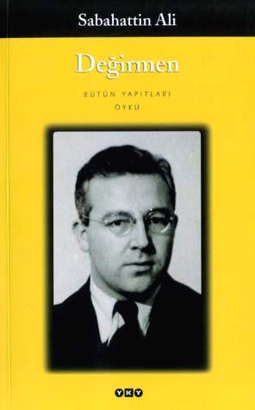
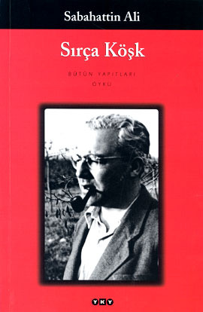
Short stories
"Değirmen" (Mill)
"Kağnı" (Oxcart)
"Ses" (Voice)
"Yeni Dünya" (New World)
"Sırça Köşk" (The Glass Palace)

Slide 8
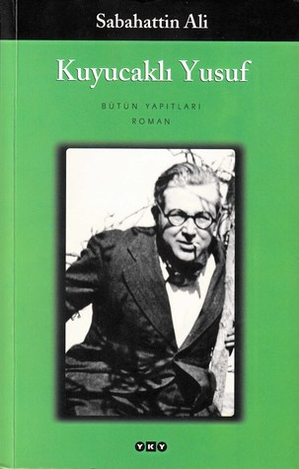
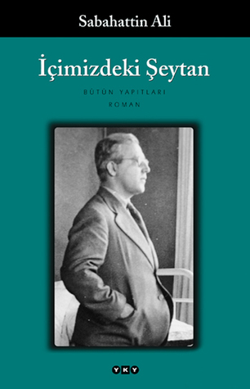
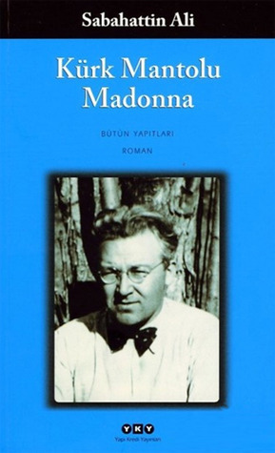
Novels
“Kuyucaklı Yusuf” (Yusuf of Kuyucak) Kuyucakli Yusuf was made into a movie by Turkish national television
“İçimizdeki Şeytan” (Devil Inside)
“Kürk Mantolu Madonna” (Madonna in a Fur Coat)

Slide 9
“Some things we never know we need until we find them.”

Slide 10
summary of the “Mill”

Slide 11
The name of the story is “Değirmen.” It means “mill.” This story is a love story, but it is not an ordinary love. The story begins with the author describing the mills.
After that, he begins to define the love for himself. He Tells that love is beautiful. He also tells that sometimes love is hurtful. Then he questions what true love is. He says love is temporary for most people. And talks about what people would sacrifice for love. And the story begins…
A group of gypsies is going somewhere. While looking for a place to take a break, they find a mill. With the miller's permission, they set up their tents and they plan to stay here for a while. The days go by without a problem. Our main character's name is “Atmaca.” It's actually a nickname, not a name. Atmaca means “hawk.” They call him so because of his black hair and dark eyes. He is a musician. He plays the clarinet very well. The clarinet is a wind instrument and its sound is wonderful. In the evenings, they have fun in front of the mill. The miller and his daughter sit and watch them.
The miller's daughter is very beautiful. But she never smiles, she is always pale, her eyes look blank. Unfortunately, this beautiful girl is disabled. She lost her right arm to the mill when she was little, she hasn’t right arm. Always feels lacking from others.

Slide 12
Atmaca, this handsome man who has never loved anyone, falls for the miller's disabled daughter.
One night, Atmaca's friend takes him to the riverside to talk. Atmaca says he loves her very much, "She loves me, she said. But she says she's missing from me because of her missing arm. So I told her she gave me her heart, is a heart worth less than an arm? Whenever I hug her, she will feel incomplete because she can't hug me.”
A few days later; Atmaca tells that he will play the clarinet at the mill in the evening. In the evening, everyone comes into the mill, the miller and his daughter too. There's a heavy rain outside, a loud rain. Atmaca plays more emotionally than perhaps ever before. He looks at the girl with such a love...
Atmaca suddenly stops playing and stands up, throwing the clarinet to the ground. The storm increases, the walls shake. Atmaca still looks at the girl. And he is thrown towards the wheels of the mill.
Even if they want to prevent it, it is too late. Atmaca's right arm is not in place and blood is flowing from it. After a few steps, he stumbles and falls to the ground.
The author says “I seen a mill before but I don’t want to see it again.”
At the end of the story, author says "But to be able to tear something that is not in your loved one's body by not being able to bear it, that is just loving."

Slide 13
“Life is a game that is only played once, and I lost. There is no second chance.”

Slide 14
thank you all.

