Slide 1
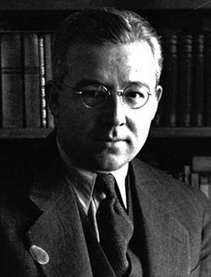
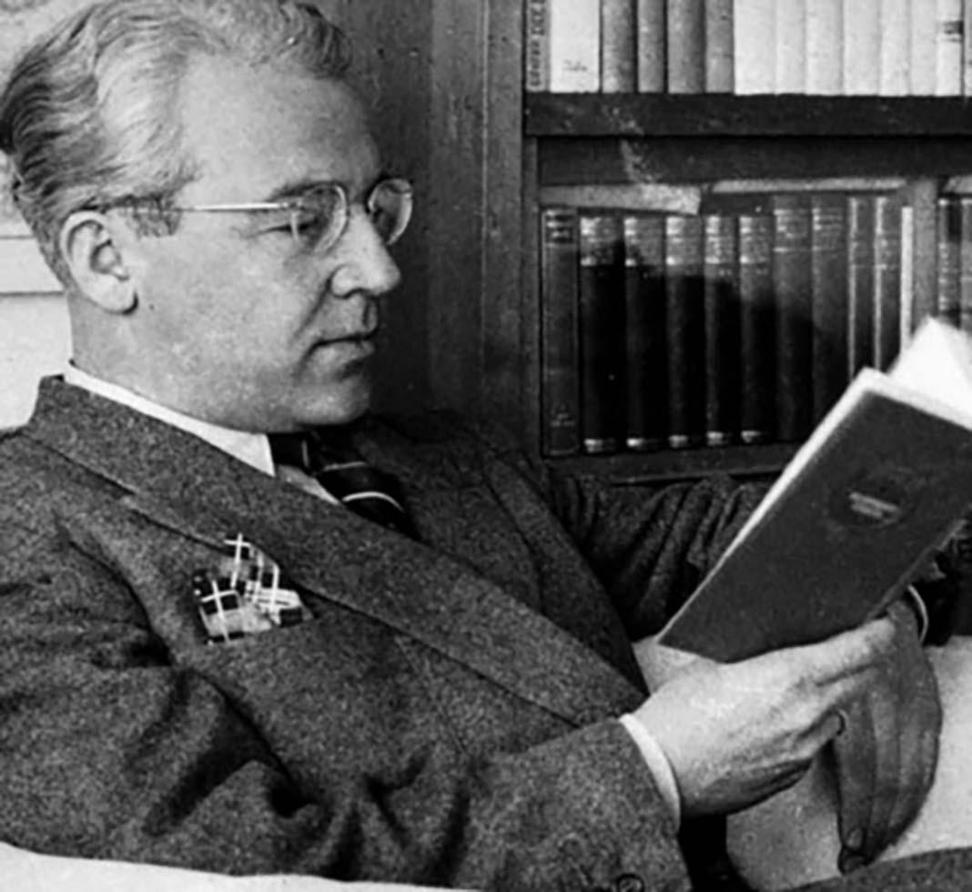
SABAHATTİN ALİ

Slide 2
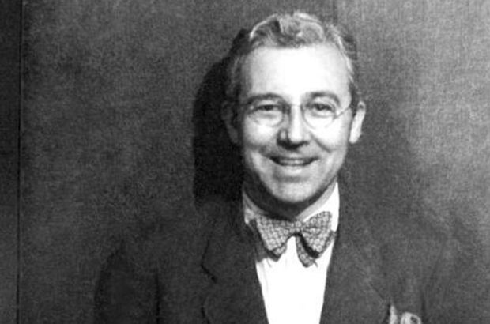
Who Is Sabahattin Ali?
Sabahattin Ali was born on 25 February 1907.
After graduating from the Edremit Primary School in 1921, the author went to his great-uncle in Istanbul and stayed there for a year. Then he returned to Balıkesir and enrolled in Balıkesir Teachers' School at the beginning of the 1922-1923 academic year.

Slide 3
Here, he started to develop his poetry and story experiences and sent articles to newspapers and magazines in the second year of school.He also published a school newspaper with his friends. During his time at this school, he started keeping a diary, went to theater and cinema more, and as a result, his interest in art increased.

Slide 4
Some works of Sabahattin Ali
SIRÇA KÖŞK
KUYUCAKLI YUSUF(YUSUF FROM KUYUCAK)
İÇİMİZDEKİ ŞEYTAN(THE DEVIL WITH IN US)
KÜRK MANTOLU MADONNA(FUR COAT WİTH MADONNA)
YENİ DÜNYA(NEW WORLD)
DEĞİRMEN(MILL)

Slide 6
KÜRK MANTOLU MADONNA
Raif Efendi went to an art gallery in Berlin when he was in his 20s at the request of his father, thanks to his interest in art. He sees the self-portrait of an artist among the paintings in the gallery and falls in love with her platonically, even though he does not know the woman in the painting at all.

Slide 7
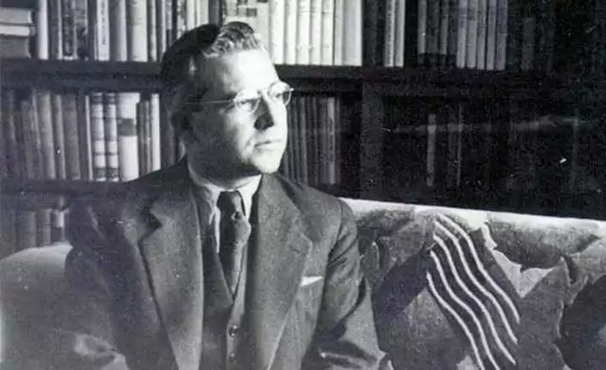
This painting awakens feelings in him that he has never felt before. Raif Efendi likens the portrait in the painting to the portrait of Madonna in the painting "Madonna delle Arpie" by the Renaissance painter Andrea Del Sarto.

Slide 8
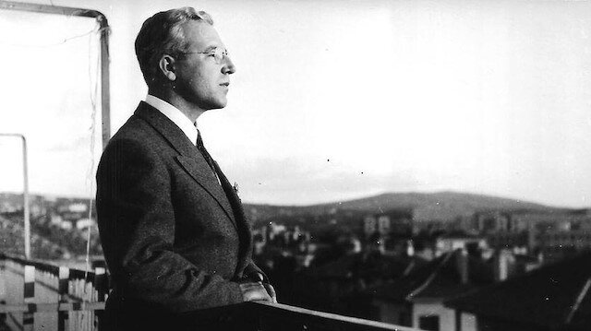
He admires the painting so much that he comes to see it whenever he gets the chance, but does not notice that other eyes are following him. In one of the sessions of watching this painting, which has now become a ritual, a woman comes to him.

Slide 9
This woman is the artist Maria Puder, who owns the painting. Maria is aware of Raif's admiration for the painting. Raif, on the other hand, thinks that he is someone who is making fun of him at first. When he learns that he is talking to the owner of the painting, his world changes irreversibly.

Slide 10
KUYUCAKLI YUSUF
District Governor Selahattin Bey goes to Kuyucak village to deal with a murder case. When he enters the house where the murder was committed, he finds the victims lying in their beds and a small child in the room. She meets this boy named Yusuf. The fact that Yusuf is very different from the children he had seen before attracts Mr. Selahattin attention.

Slide 11
Selahattin Bey, who does not have a son, adopts Yusuf. Selahattin Bey's wife Şahinde does not want this child at all. But it can only be said. Muazzez, the daughter of the house whose Hayla is a baby, loves Yusuf very much. Yusuf, who is not interested in anything, also gets along very well with Muazzez. Yusuf has a different family life in his new house than before.

Slide 12
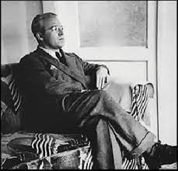
While Mr. Selahattin does not come home until late in order not to hear Şahinde's nagging, Şahinde also spares time for visits throughout the day. Yusuf and Muazzez grew up in such an environment. Yusuf grows up when his family is murdered when he was a little boy.

Slide 13
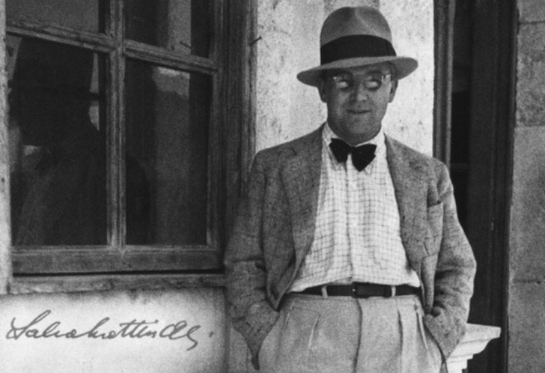
Joseph's life has been shaped by others from that point forward. Despite adapting to his new life and trying to turn a new page, he cannot always feel that he belongs to the place where he lives.

Slide 14
She grows up, falls in love, gets married, but still can't get rid of that strange feeling. If we need to analyze the character of Yusuf, he is very passive, introverted, living all the wars within himself, often resorting to brute force and always coming to his senses later.

Slide 15
THANKS FOR LISTENING…
DURU HAYAT KESKİN
ŞEVVAL ARSLAN

