Slide 1
RIFAT ILGAZ

Slide 2
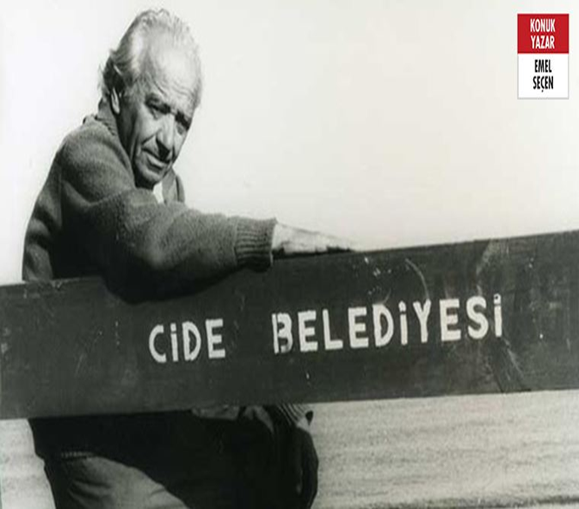
WHO IS RIFAT ILGAZ?
Mehmet Rıfat Ilgaz was born in 1911 in the small town of Cide on the Black Sea. He was a Turkish teacher, author and poet.
In 1930 he graduated from Kastamonu Teaching College and taught Turkish at schools in Adapazarı and Istanbul.
In 1938 he graduated from Gazi Institute of Education ,the Department of Literature .

Slide 3
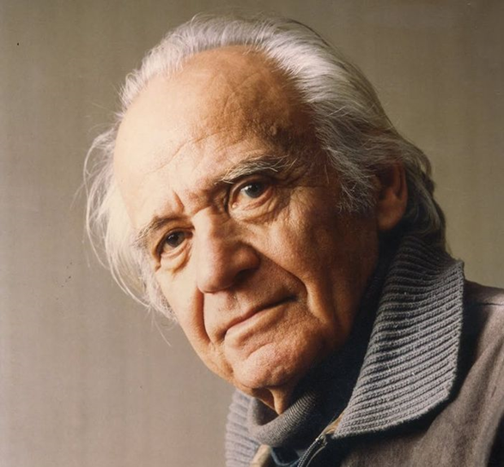
WHO IS RIFAT ILGAZ?
He has also a successful career in Turkish Literature as a lecturer.
The author has thousands of short stories, poems, novels, plays, memories, and articles. The most famous work is ‘’Hababam Class’’.

Slide 4
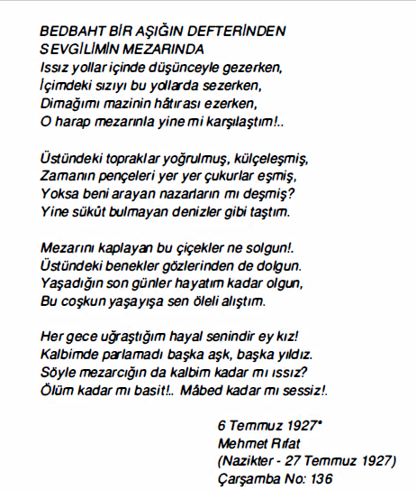
The Importance of Rıfat Ilgaz in Turkish Literature
Rıfat Ilgaz started to write poetry in his primary school years. He is one of the productive, social and realistic writers of 20th century Turkish Literature.
The first published work of Rıfat Ilgaz is the poem ‘’ In My Darling Grave’’, which he wrote at the age of 15.

Slide 5
The Importance of Rıfat Ilgaz in Turkish Literature
Rıfat Ilgaz worked as a teacher during the Second World War. He talked about the problems he observed in society during this period in his writings.
His first poetry book ‘’Fellowship’’ is the best example telling about these problems of the society at that term.

Slide 6
Works of Rıfat Ilgaz

Slide 7
Rıfat Ilgaz's Works in the Novel Type
Pijamalılar (In Pajamas)
Hoca Nasrettin ve Çömezleri (Hodja Nasrettin And His Rookies)
Meşrutiyet Kıraathanesi (The Cafe Of Constitutional)
Apartman Çocukları. (Apartment Kids)
Yıldız Karayel (Star & Mistral)
Sarı Yazma ( Yellow Scarf )
Karartma Geceleri (Blackout Nights )
Karadeniz'in Kıyıcığında (On The Black Sea Coast )
Hababam Sınıfı(Hababam Class)

Slide 8
Rıfat Ilgaz's Poetry Books
Kulağımız Kirişte (Our Ear Is Close To The Ground )
Güvercinim Uyur mu? (Do My Pegion Sleep ?)
Ocak Katırı Alagöz ( Mule Alagöz)
Yarenlik (Fellowship)
Üsküdar'da Sabah Oldu.( Morning In Üsküdar)

Slide 9
Rifat Ilgaz's Story Books
Çalış Osman Çiftlik Senin ( Work Osman, The Farm Belongs To You )
Nerde Eski Ustalar? (Where Is The Senier Master?)
Sosyal Kadınlar Partisi (Social Women Party )
Rüşvetin Almanca‘ sı. ( The Bribery In German)

Slide 10
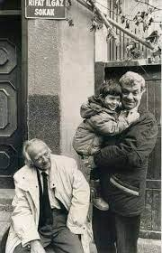
HABABAM CLASS
Rıfat Ilgaz's the most famous humor work is the ‘’Hababam Class’’
Hababam Class is about the teachers and pupils of boys in a boarding school.
He was deeply inspired by his own son’s school adventures and stories,while writing Hababam Class.

Slide 11
HABABAM CLASS
This work tells about the events experienced by the students of a boarding school in Istanbul, among themselves, the school staff and their teachers.
He humorously criticizes the education system in Türkiye.
In this work, the author talks about the events related to cheating, memorization and fabricated respect. Criticized the education system over these events.

Slide 12
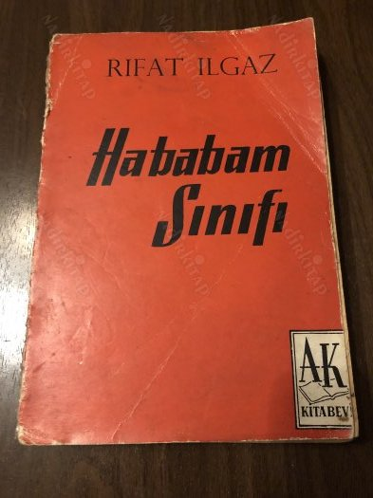
HABABAM CLASS
Hababam Class was published as short stories in the Dolmuş Magazine for 78 weeks from 1956. It was later turned into a novel, a musical, a play and a movie.
‘’Hababam Class’’ was first published as a book in 1957.

Slide 13
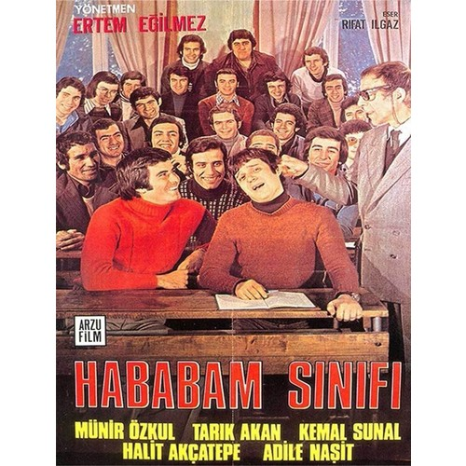
HABABAM CLASS
It was adapted into a movie 9 times by 3 different directors between 1975 and 2006.
Hababam Class films have become one of the films that are frequently broadcast on television and have a high viewing rate.

Slide 14
FEATURED CHARACTERS

Slide 16
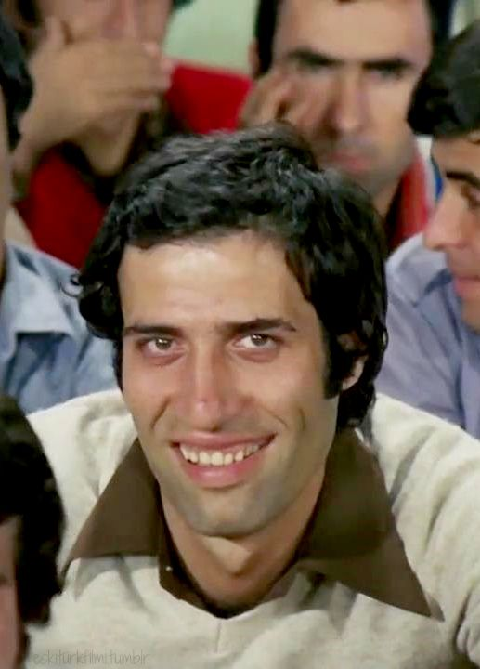
İNEK ŞABAN
Kemal Sunal played the character of İnek Şaban.
He is a gullible person.
He makes you laugh especially with his facial expressions in the movie.

Slide 17
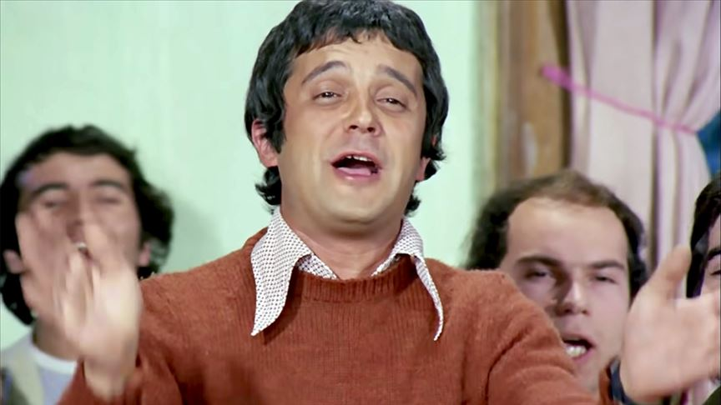
GÜDÜK NECMİ
Halit Akçatepe played the character of Güdük Necmi.
He was nicknamed the Güdük because of his short stature.
Always makes childish jokes to İnek Şaban.

Slide 18
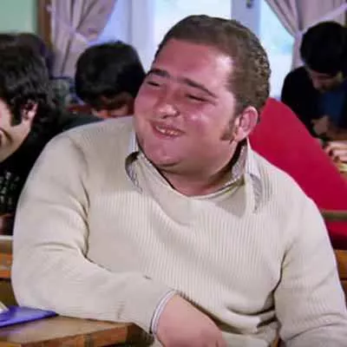
DOMDOM ALİ
Feridun Şavlı played the character of Domdom Ali.
He is one of the fat and mischievous students of the Hababam Class.
He was nicknamed Domdom because he was fat.

Slide 19
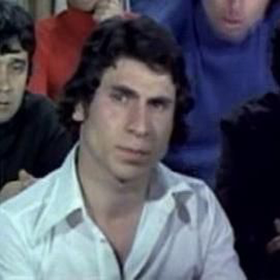
HAYTA İSMAİL
Ahmet Arıman played the character of Hayta İsmail.
He is one of the leading figures of the class. He is also short and his smile at funny events is very different.

Slide 20
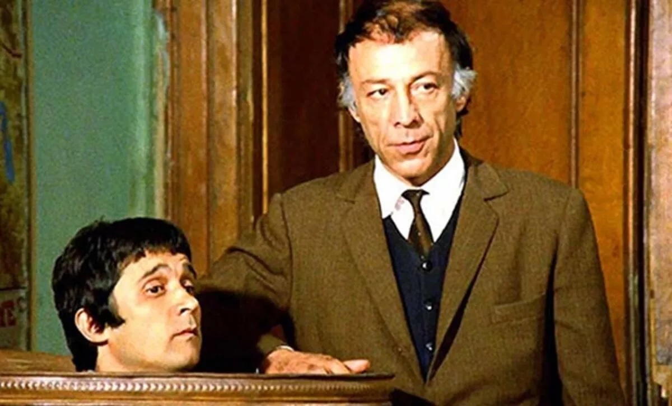
KEL MAHMUT
Münir Özkul played the character of Kel Mahmut.
He is the old, disciplined but kind-hearted assistant principal and history teacher of the school.

Slide 21
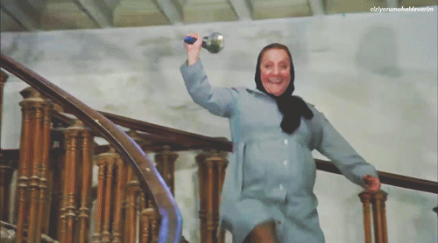
HAFİZE ANA
Adile Naşit played the character of Hafize Ana.
Hafize Ana is the janitor and cooker of the school.
She is very close to the students. She watches and protects them. She tries to help in every way.

Slide 22
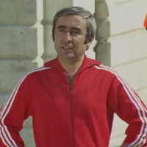
BADİ EKREM
Şener şen played the character of Badi Ekrem.
Badi Ekrem is a Physical Education teacher.

Slide 23
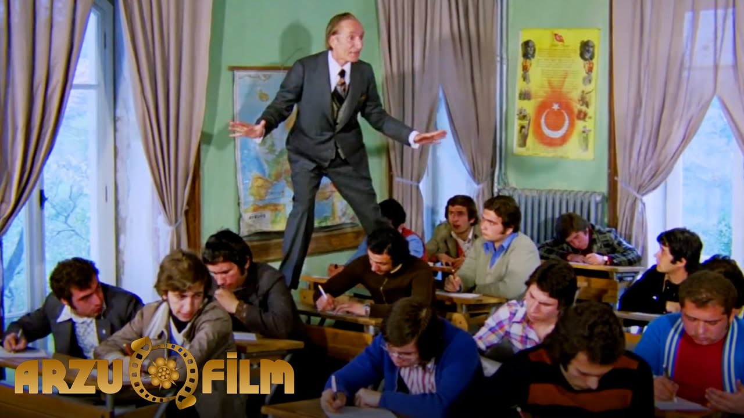
KÜLYUTMAZ
Ertuğrul Bilda played the character of Külyutmaz.
He is a biology teacher.
He does everything to prevent students from cheating.

