Slide 1
Italian lesson

Slide 2
ITALIAN GREETINGS 🔜

Slide 3
Hello | Ciao🙋🏼‍♀️
Good morning | Buon giorno☀️
Good afternoon | Buon pomeriggio 🌅
Good evening | Buona sera🌙
Good night | Buonanotte💤
Goodbye | Arrivederci 😙
See you soon | Ci vediamo presto 🫂

Slide 4
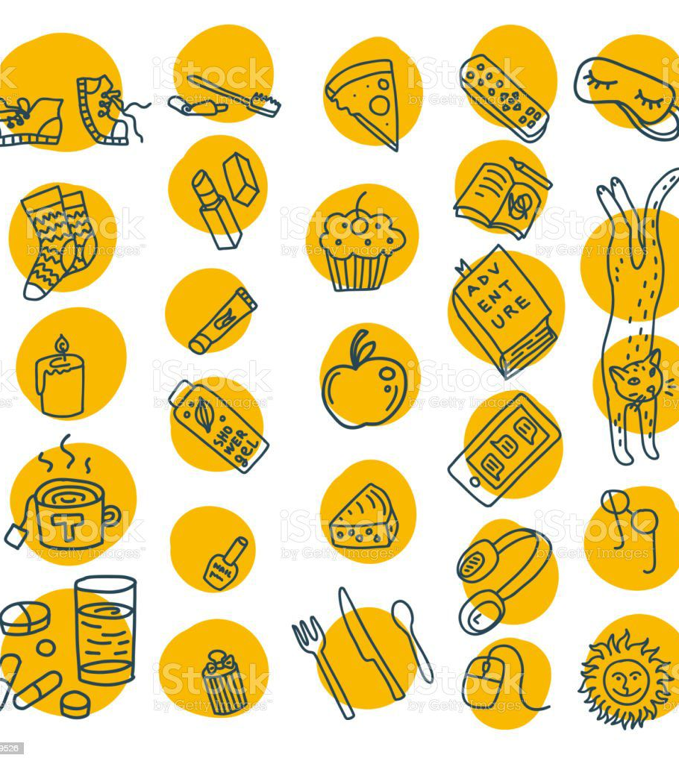
Everyday objects

Slide 5
Pen | PENNA 🖊 | Book | LIBRO 📚
Pencil | MATITA ✏️ | Trousers | PANTALONI 👖
Phone | TELEFONO 📞 | Socks | CALZINI 🧦
Face makeup | TRUCCHI 💄 | Dress | VESTITO 👗
Shoes | SCARPE 👞 | Hat | CAPPELLO 🧢

Slide 6
Days of the week
Monday | Lunedì 😫
Tuesday | Martedì 😩
Wednesday | Mercoledì 🫤
Thursday | Giovedì 😐
Friday | Venerdì 🙂
Saturday | Sabato 😄
Sunday | Domenica🤩

Slide 7
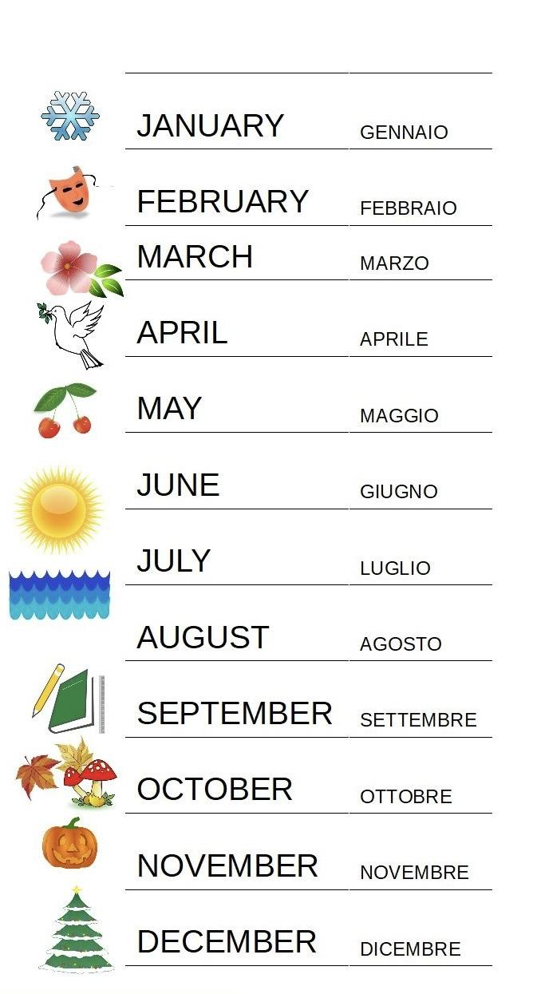
Seasons
Months
WINTER ❄️ | INVERNO
SRING 🌸 | PRIMAVERA
SUMMER⛱ | ESTATE
AUTUMN 🍂 | AUTUNNO

Slide 8
Family members 👨‍👩‍👧‍👦
Mom | Mamma🤰🏼
Dad | Papà👨🏻‍🍼
Sister | Sorella 👧🏼
Brother | Fratello🧒🏼
Grandmother | Nonna👵🏻
Grandfather | Nonno👨🏻‍🦳
Aunt | Zia👩🏻‍🦰
Uncle | Zio👱🏼‍♂️
Cousin | Cugino/a👩🏼‍🦱🧑🏻‍🦱

Slide 9
numbers 🔢
30 THIRTY
40 FORTY
50 FIFTY
60 SIXTY
70 SEVENTY
80 EIGHTY
90 NINETY
100 ONE HUNDRED
TRENTA
QUARANTA
CINQUANTA
SESSANTA
OTTANTA
NOVANTA
CENTO
1 ONE UNO
2 TWO DUE
3 THREE TRE
4 FOUR QUATTRO
5 FIVE CINQUE
6 SIX SEI
7 SEVEN SETTE
8 EIGHT OTTO
9 NINE NOVE
10 TEN DIECi
11 ELEVEN UNDICI
12 TWELVE DODICI
13 THIRTEEN TREDICI
14 FOURTEEN QUATTORDICI
15 FIFTEEN QUINDICI
16 SIXTEEN SEDICI
17 SEVENTEEN DICIASSETTE
18 EIGHTEEN DICIOTTO
19 NINETEEN DICIANNOVE
20 TWENTY VENTI

Slide 10
food
tomato POMODORO 🍅
potatoes PATATE 🥔
bread PANE 🍞
apple MELA 🍎
fish PESCE 🐟
cheese FORMAGGIO 🧀
ice cream GELATO 🍦
eggs UOVA 🥚
biscuits BISCOTTI 🍪
vegetable VERDURA 🥒
milk LATTE 🍼
chicken POLLO 🍗
cake TORTA 🍰
coffee CAFFÈ ☕️
wine VINO 🍷
water ACQUA 💧
lemon LIMONE 🍋
cherry CILIEGIE 🍒

Slide 11
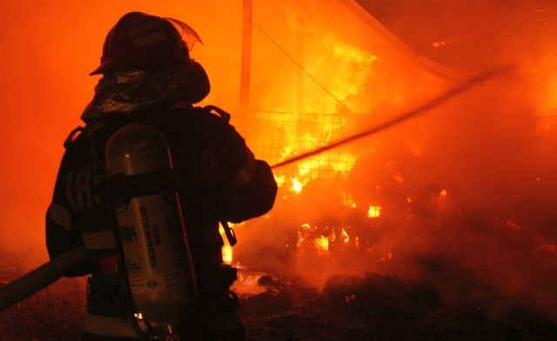
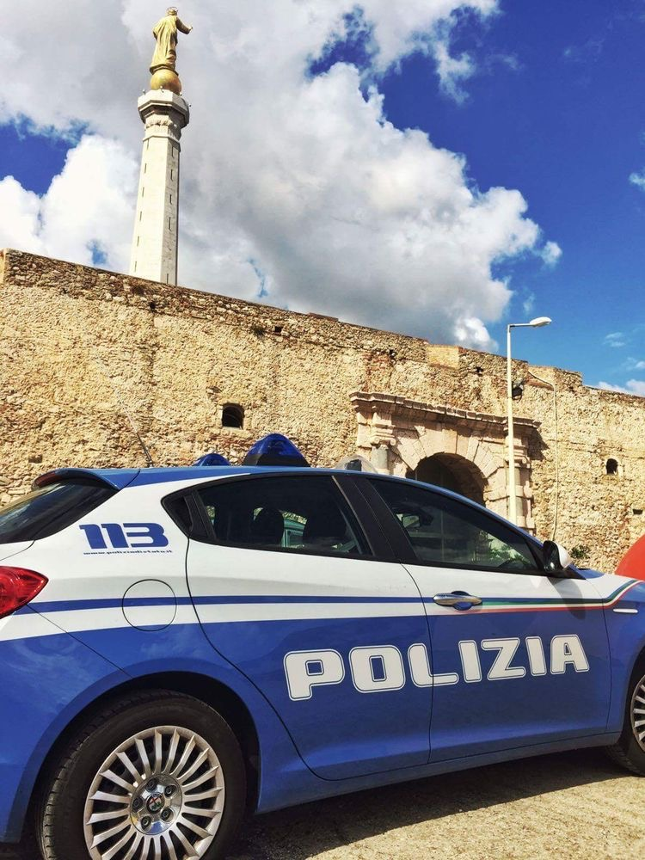
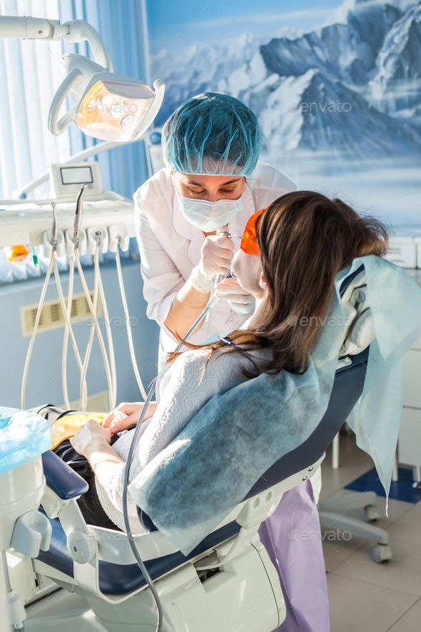
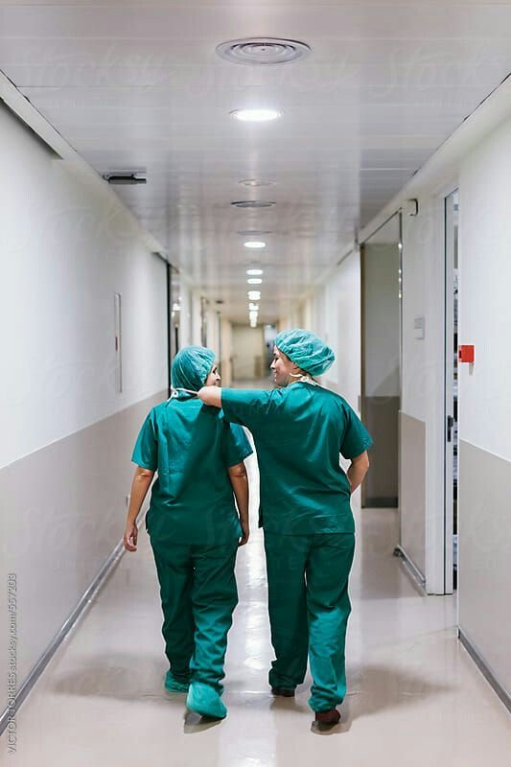
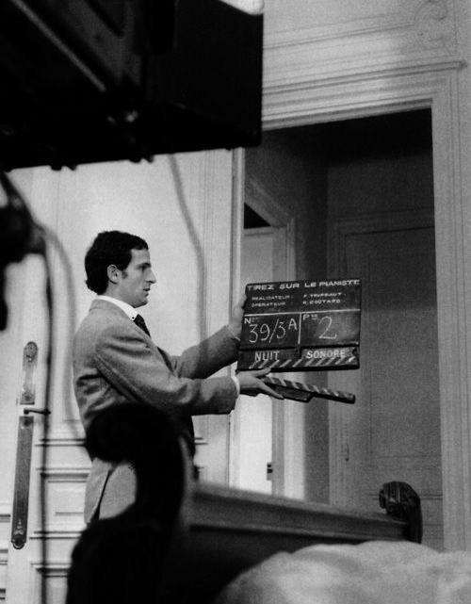
JOBS
policeman POLIZIOTTO 🚓
fireman POMPIERE 👩‍🚒
teacher INSEGNANTE👨‍🏫
actor ATTORE 📽️
engineer INGEGNERE 📐
cook CUOCO 👨‍🍳
doctor DOTTORE 🥼
dentist DENTISTA 🦷
nurse INFERMIERA 👩‍⚕️
office worker IMPIEGATO 👨‍💼
lawyer AVVOCATO 🧑‍💼

Slide 12
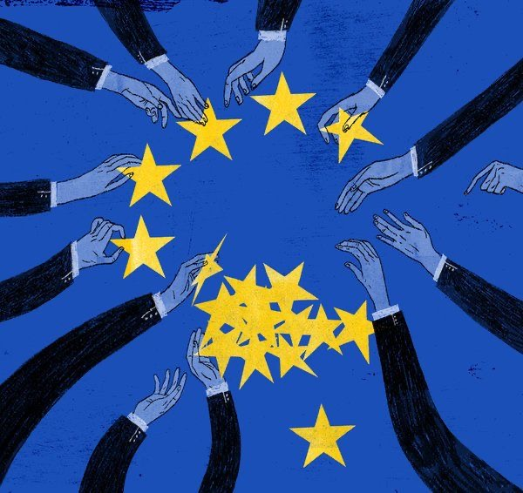
COUNTRIES:
Hungary UNGHERIA
United Kingdom REGNO UNITO
France FRANCIA
Spain SPAGNA
Turkey TURCHIA
Netherlands PAESI BASSI
Greece GRECIA
Poland POLONIA
Lithuania LITUANIA

Slide 13
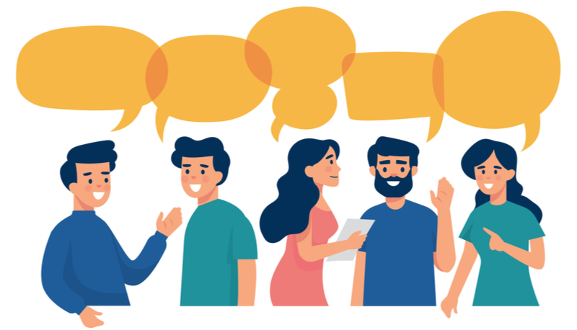
let’s have a conversation
What's your name? Come ti chiami?
Where are you from? Da dove vieni?
How are you? Come stai?
How old are you? Quanti anni hai?
What's your favourite colour? Quale è il tuo colore preferito?
What's your favourite animal?
Quale è il tuo animale preferito?
Who are you? Chi sei?
My name is… Mi chiamo......
I'm from .... Vengo da.....
I'm very well, thank you. Sto bene, grazie
I' m 13 (years old). Ho 13 anni
My favourite colour is pink.
Il mio colore preferito è il rosa
My favourite animal is the cat
Il mio animale preferito è il gatto
I'm Luca Sono Luca

Slide 14
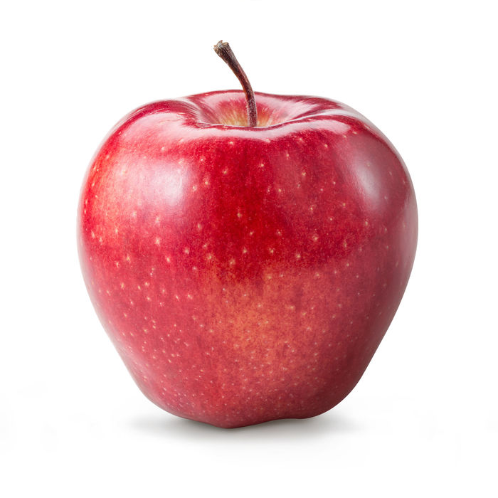
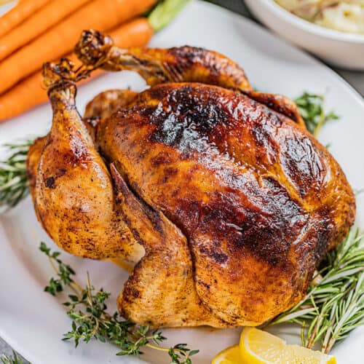
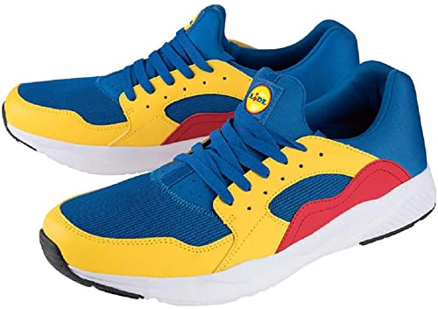
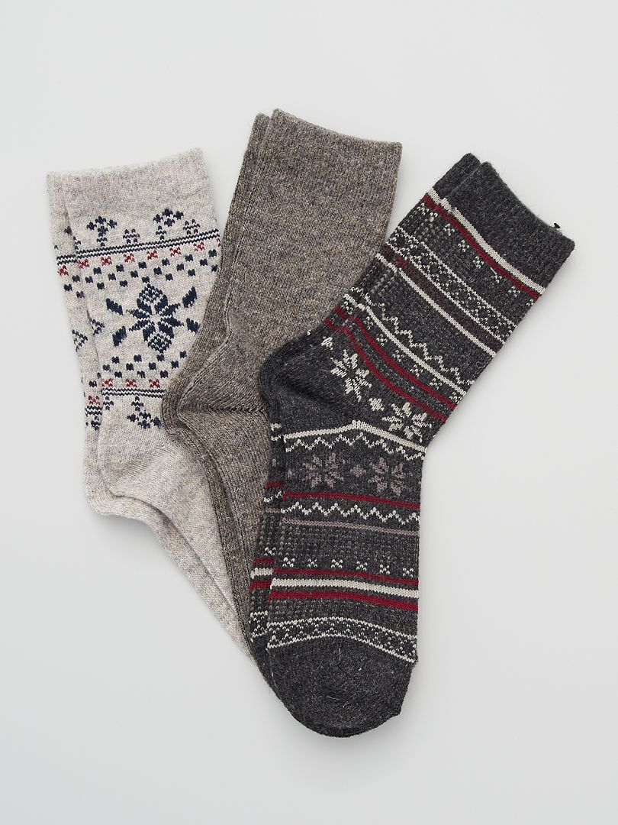
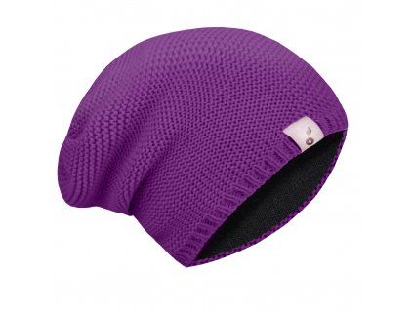
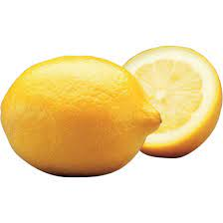
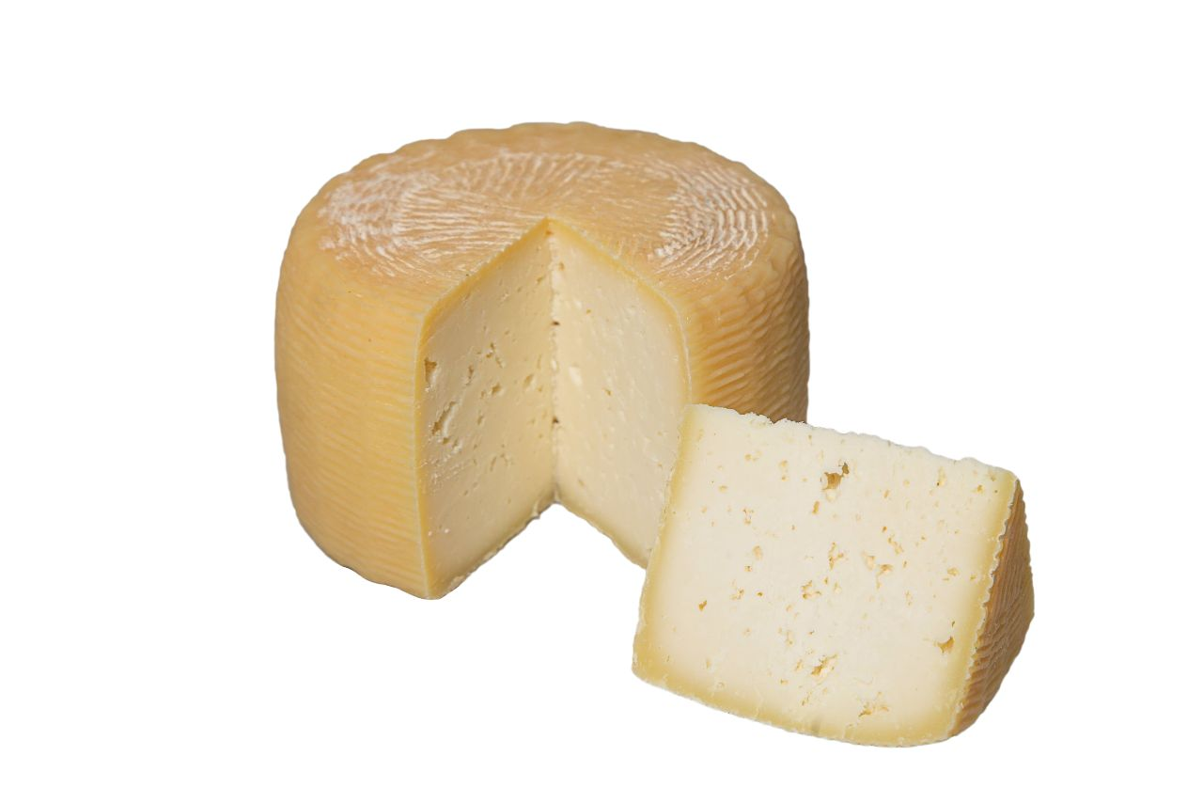
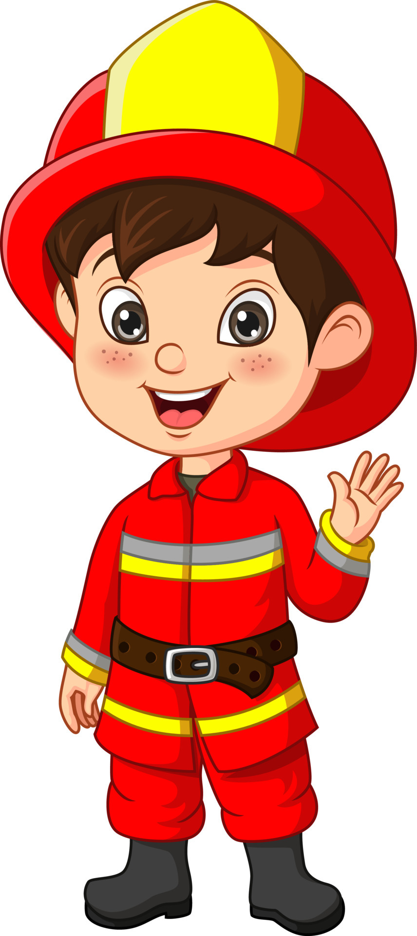
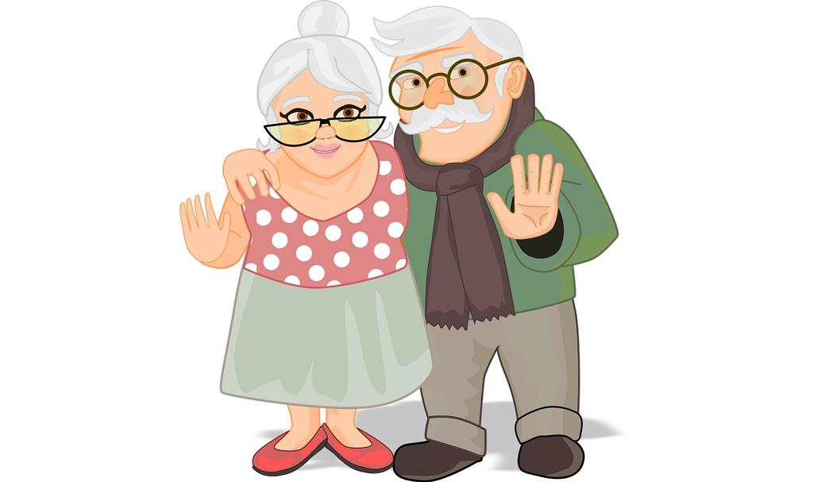
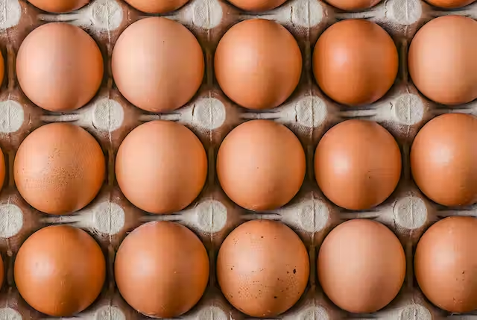
Ex. I. How do you say these in italian…?

Slide 15
Ex. Ii. Answer the questions in italian
Which days are free from school in your country?
Which is the first day after the weekend?
Which month were you born in?
What are the winter months?
How old are you?
Which country do you live in?
What cold dessert do you eat in the summer?
Who is your mother’s sister?
Who is your parents’ son?
What do you say when you go to bed?

Slide 16
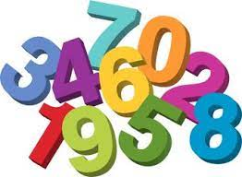
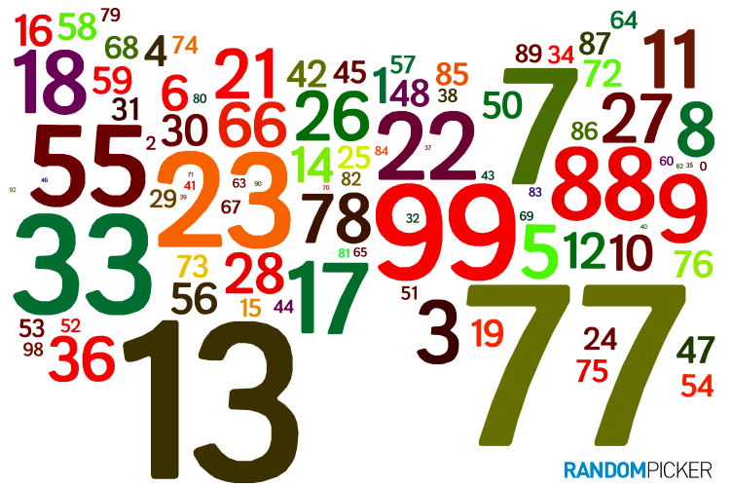
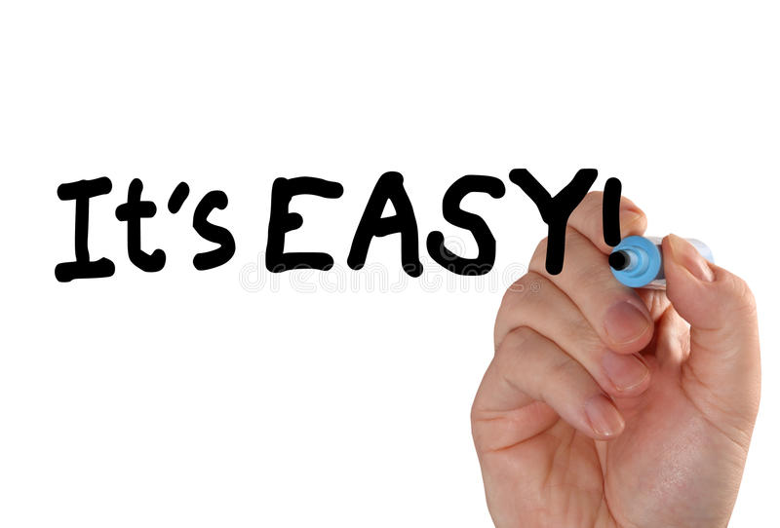
Ex. III. How do you say these numbers in italian?

Slide 17
ex. Iv. What do you say in italian…?
at 7 p.m. when you meet somebody
when you go away
when you enter the school in the morning
if someone asks you how old you are
if someone asks you where you’re from
if someone asks you what day it is today
if someone asks you what day it is tomorrow
to say thanks

