Slide 1
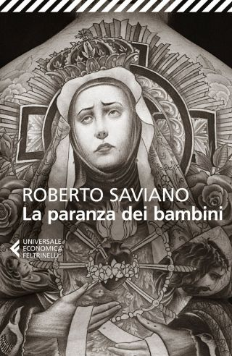
LA PARANZA DEI BAMBINI
Piranhas by R. Saviano
ROBERTO SAVIANO
“A look is a territory, it is the homeland; to look at someone is to enter their house without permission, staring at someone and invading them. Not turning your gaze is a manifestation of power.”

Slide 2
THE PLOT
Ten kids on scooters whizz through on their conquest of Naples. Fifteen-year-olds with harmless nicknames – Maraja, Pesce moscio,Dentino, Lollipop, Drone – they have designer shoes, normal families and girls’ names tattooed on the skin. Teenagers who don't have tomorrow . They are not afraid of prison or death. They know that money belongs to those who take it. So, off they go on the mopeds, to get the money but, above all, power. The novel tells about the controversial rise of a paranza – a group linked to the Camorra – and its leader, Nicolas Fiorillo. Looking at the city from its rooftops, they learn to shoot with guns and AK-47, targeting the antennae, then they go down the streets to sow terror, riding their scooters. Gradually, they gain control of neighbourhoods, taking them away from opposing gangs, forging alliances with declining old bosses. “Paranza” is a name that comes from the sea, the name of fishing boats. As in trawling, the paranza goes to fish people to be killed. It is a story of children who cheer for life like fish, of adolescence deceived by the ‘light’, and of deaths that produce deaths.

Slide 3
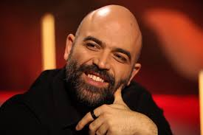
ROBERTO SAVIANO
BIOGRAFIA
Roberto Saviano (born in 1979) is an Italian writer, essayist, journalist, and screenwriter. In his writings, including articles and his book Gomorrah, he uses literature and investigative reporting to tell of the economic reality of organized crime in Italy, in particular the Camorra crime syndicate, and of organized crime more generally. He also collaborates with international and Italian newspapers, such as L’Espresso, La Repubblica, the New York Times and The Times.
Since 2006 he has been living under guard, following threats received by the Camorra cartels and in September 2016 he was awarded by German Chancellor Merkel with the M100 Sanssouci Colloquium Award which is given to journalists and writers who stand out for their courage.

Slide 4
‘In Naples there are no paths of growth: you are already born in reality, inside, you do not discover it slowly’.
This is a quote that impressed me a lot and explains that this is a world where teenagers have been taken away from time, both the past and the future; they only have an eternal present in which they go through their daily lives, without school, family dinner, or dates with girls. There is no time to think about future: these boys have learned right away that it is useless to engage in study and life, the important thing is to make money, now. They know that if you believe that at the end of the day you will get something, you are wrong. Paranza is the right metaphor.

Slide 5
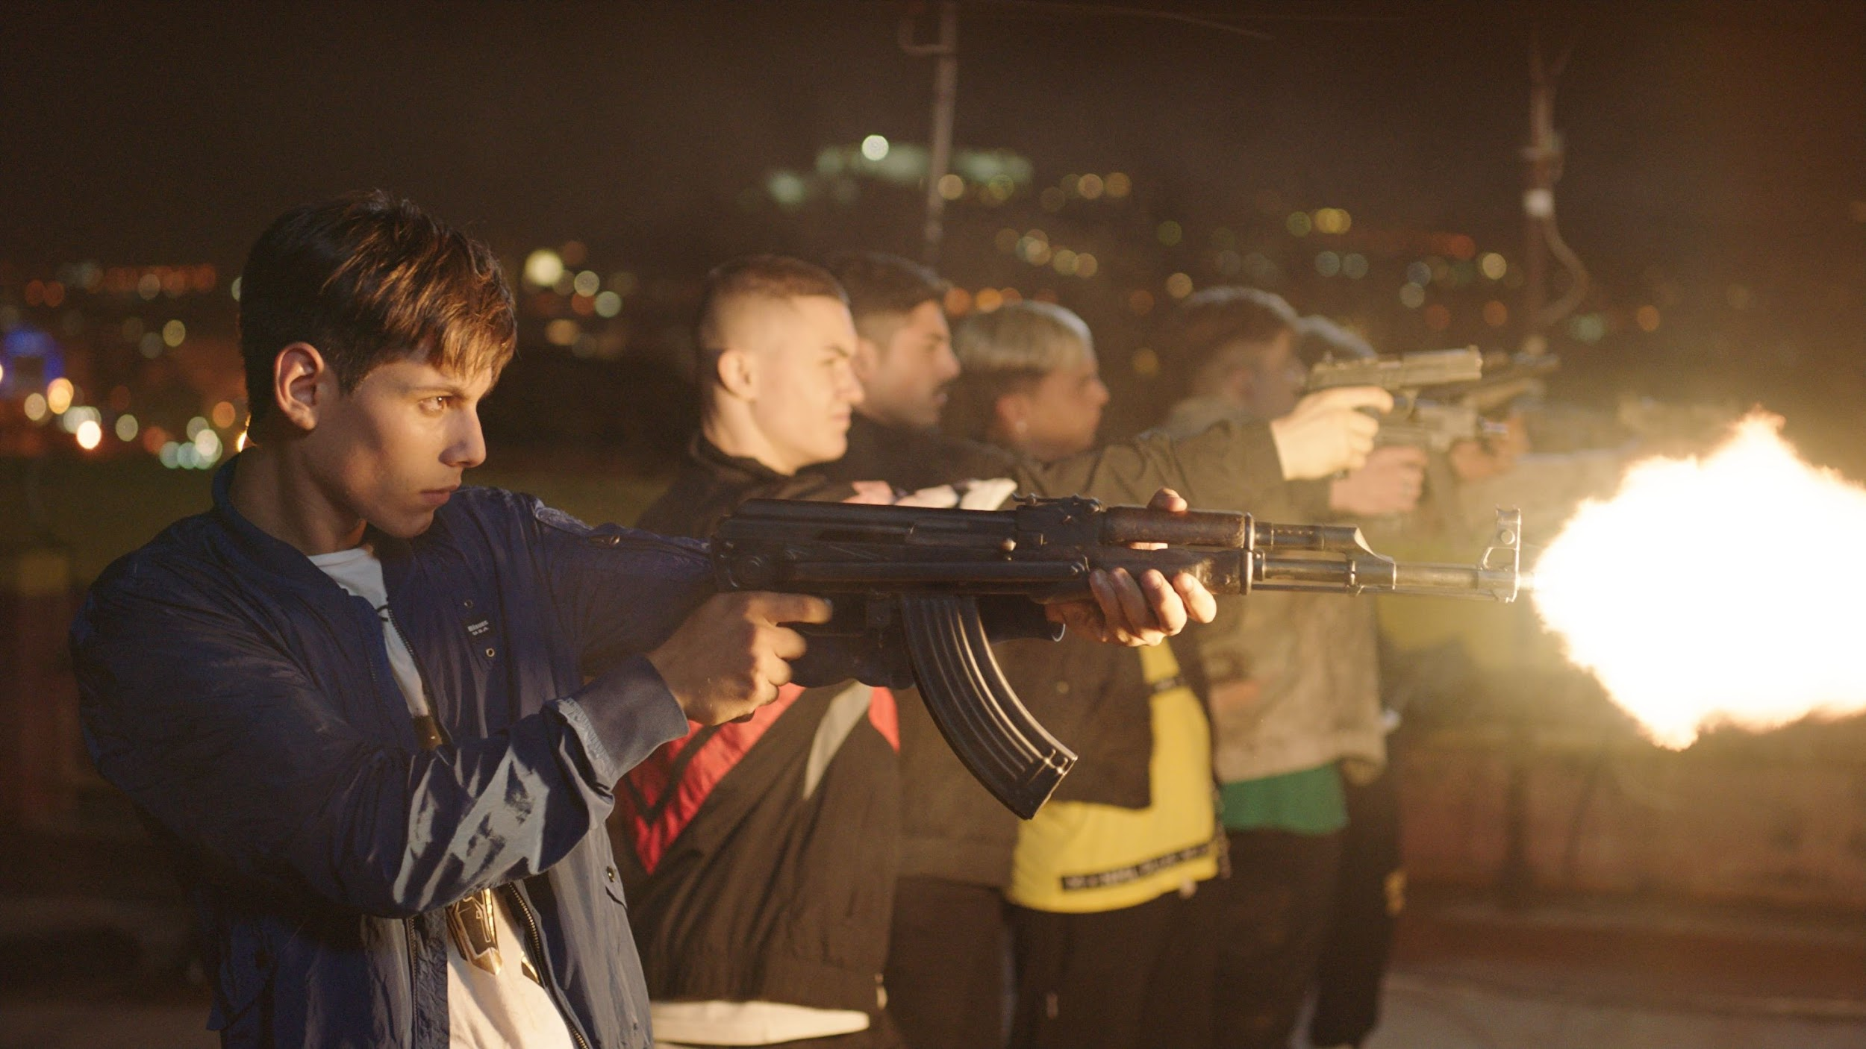
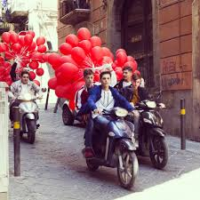
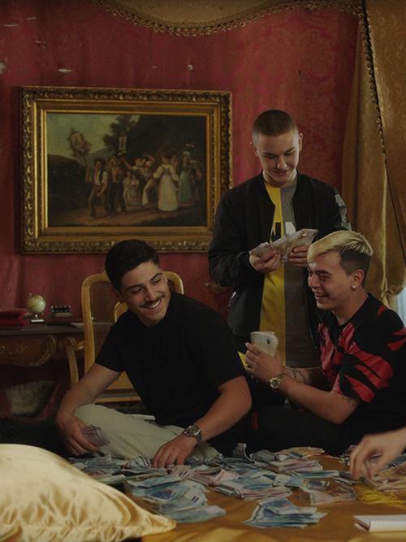
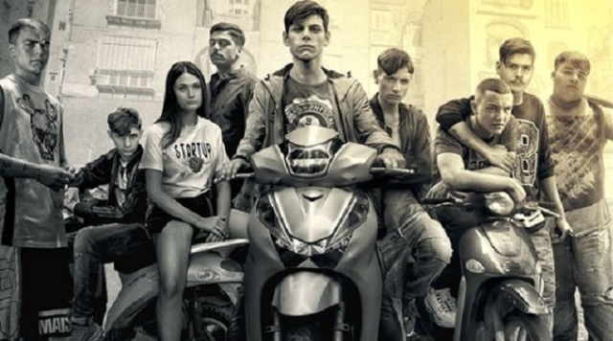
a

