Slide 1
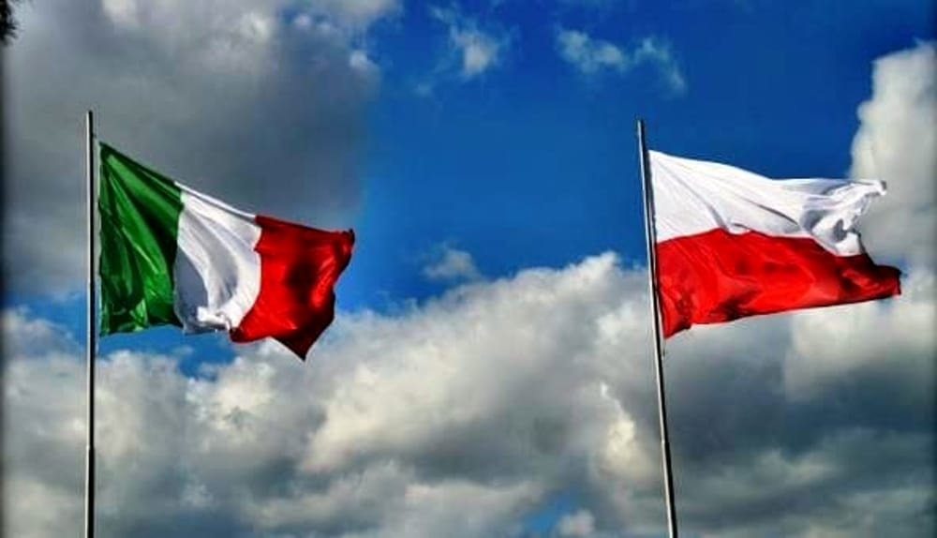
Relations between
Italy and Poland

Slide 2
There are several relations between Italy and Poland such as the presence of the Catholic religion and historical similarities. Many people have defined these relations as the Polish-Italian brotherhood.

Slide 3
Bona Sforza (Duchess of Bari), a member of the powerful Milanese house of the Sforza, in 1518 became the second wife of Sigismund I the Old, king of Poland from 1506 to 1548.

Slide 4
The Renaissance spread in Poland thanks to Italian artists like Francesco Fiorentino, Bartolomeo Berecci, Santi Gucci and Bernardo Morando that projected Zamość, Tomaszów Lubelski and other city buildings.

Slide 5
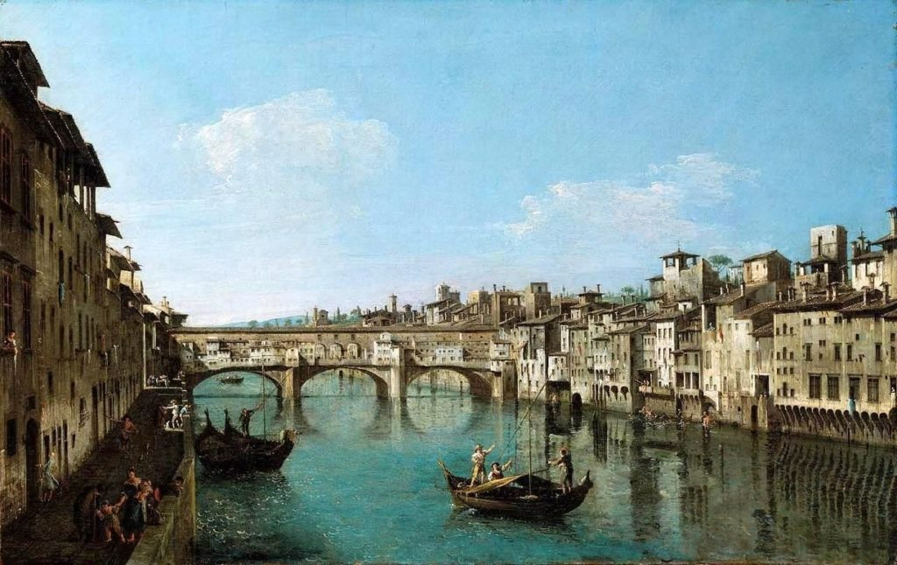
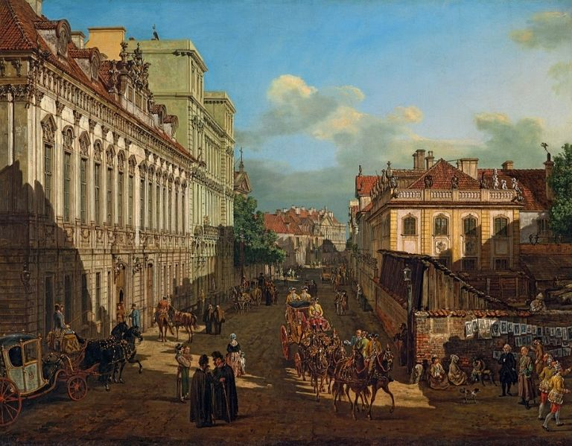
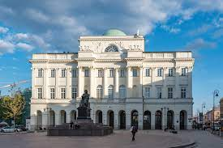
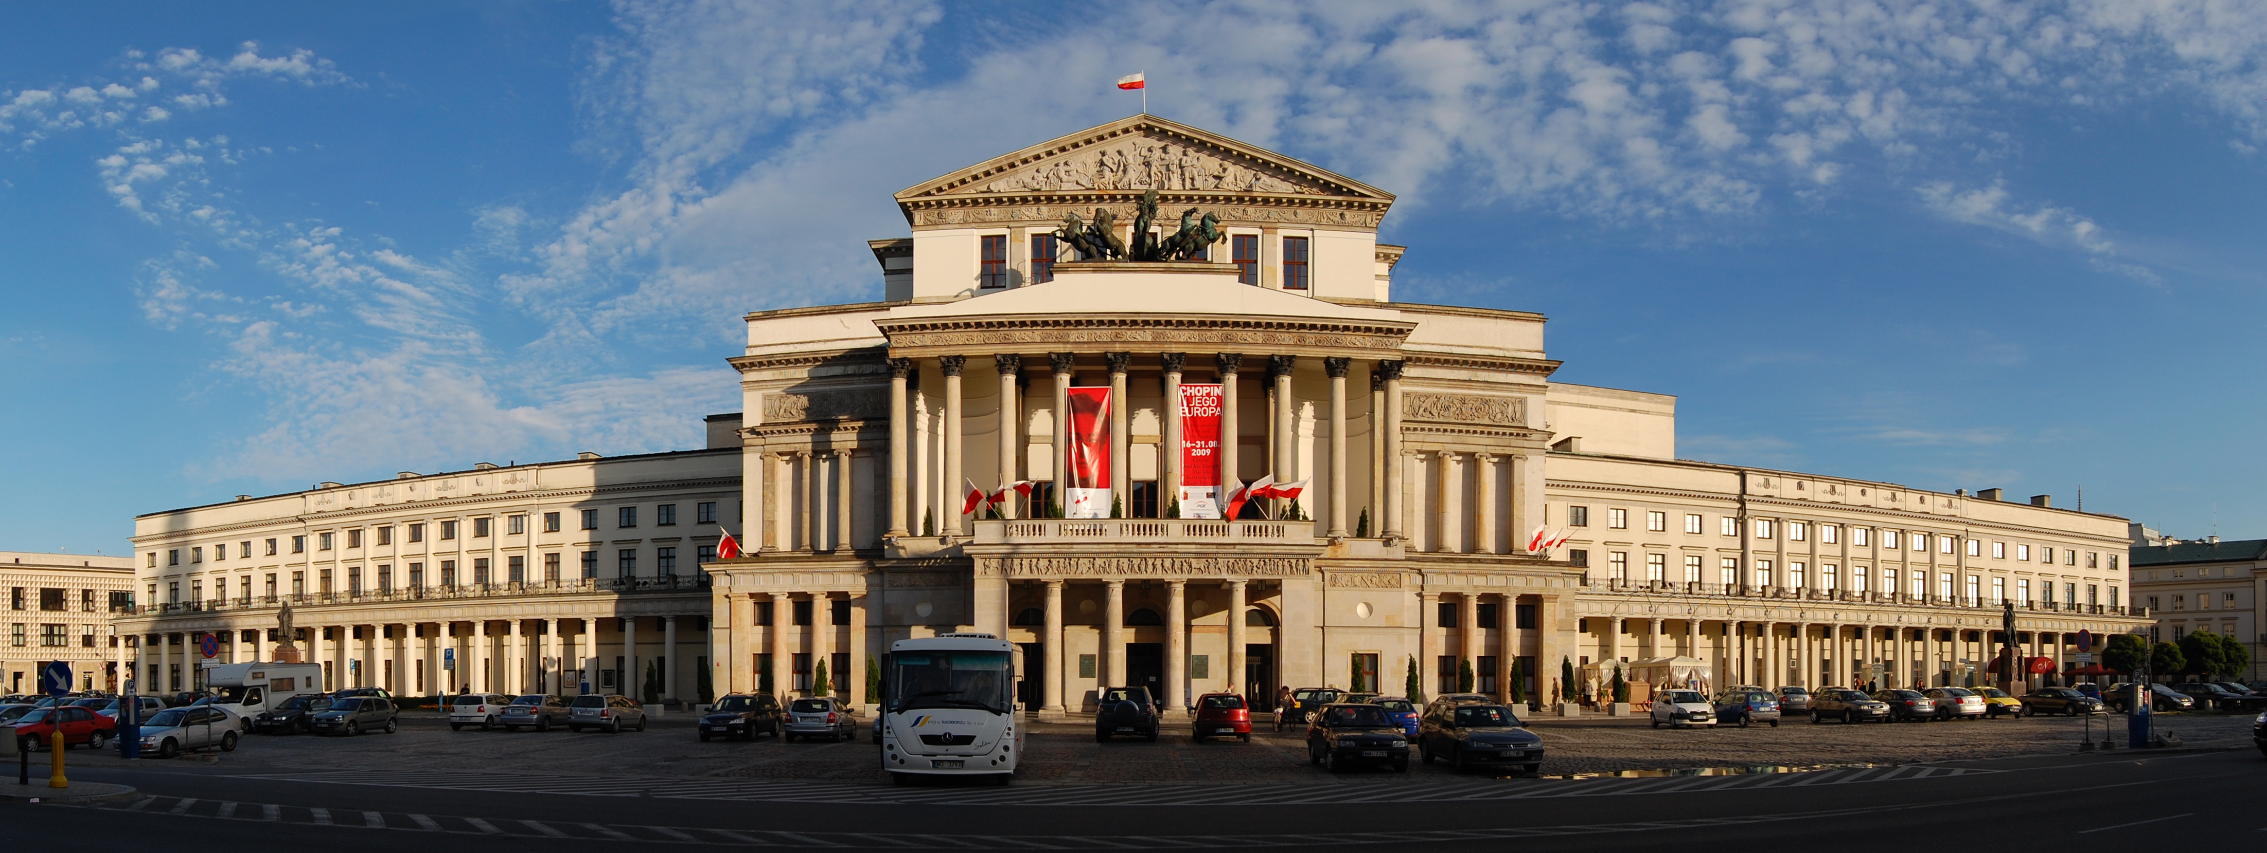
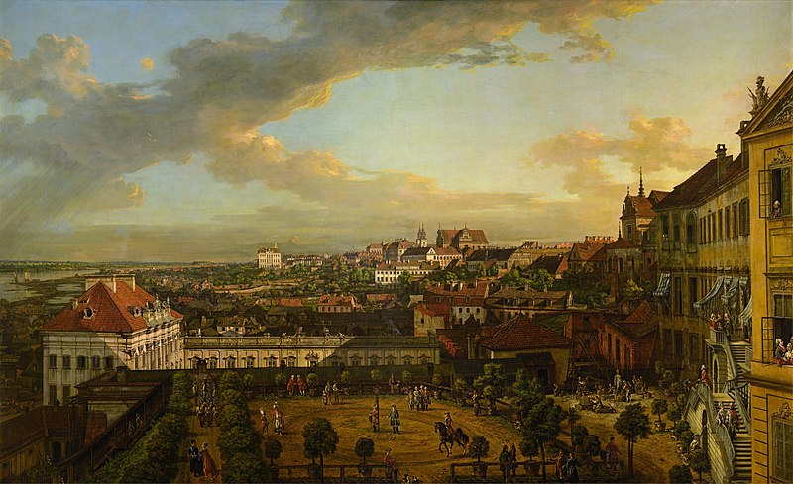
Bernardo Bellotto, known in Poland as Canaletto, painted 26 views of Warsaw which were used to rebuild the city after the destruction caused by the World War II.
Antonio Corazzi designed many buildings in Warsaw, such as “Staszic Palace” and “Wielki Theatre”

Slide 6
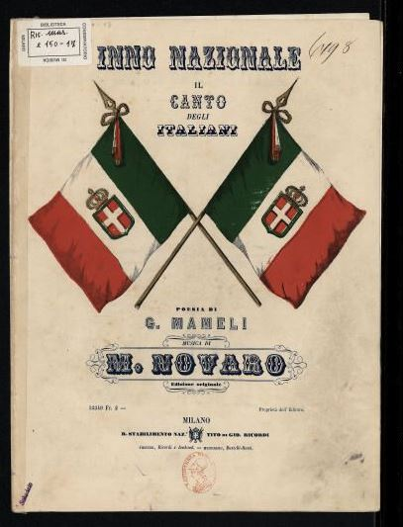
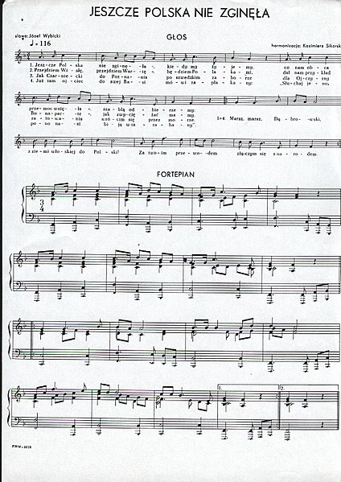
The Italian and the Polish anthems have historical references in common: in the Italian anthem, the last line refers to the “Polish blood" drunk together with the “Cossack”; in the Polish one the reference is explicit: “March, March Dabrowski, from Italy to Poland”.

Slide 7
In 1978 the Pole Karol Wojtyla was elected the Catholic Pope, the first non-Italian Pope since the 16th century.

Slide 8
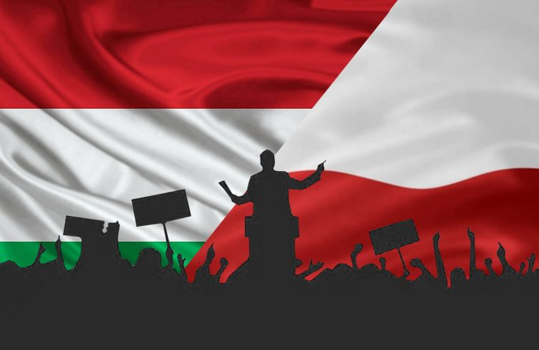
Current connections
Italy has got an embassy in Warsaw and two honorary consulates;
Poland has got an embassy in Rome and two general consulates;
There are around 109.018 Poles in Italy;
There are about 8.000 Italians in Poland;
The most practiced religion in both countries is Roman Catholicism.

Slide 9
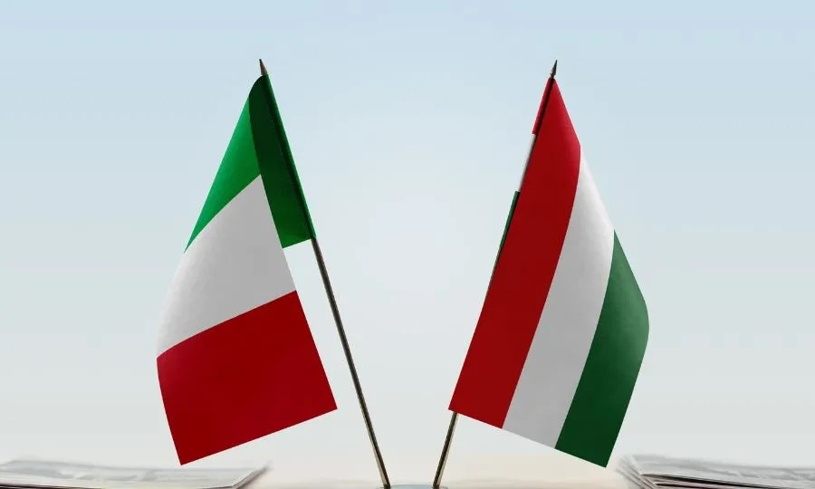
Relations between
Italy and Hungary

Slide 10
A Venetian nobleman named Gherardo Sagredo spread Christianity among pagan Hungarians: he was the first bishop of Csanád, who suffered martyrdom, and is now venerated in Hungary as a national saint. The cliff which dominates the Hungarian capital and was once the place of his martyrdom, now bears his name.

Slide 11
Mattia Corvino brought the Italian Renaissance to Hungary by promoting art and literature.

Slide 12
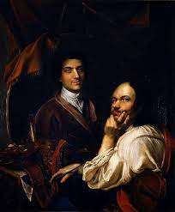
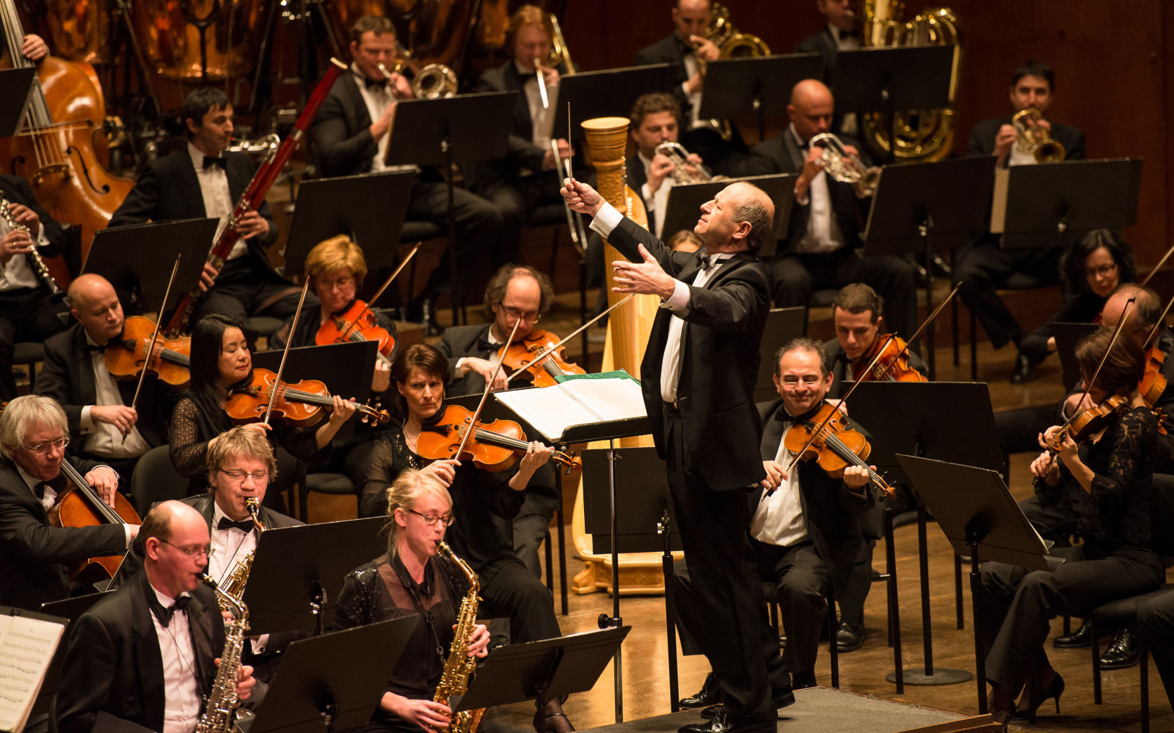
Cultural cooperation between Hungary and Italy is particularly intense. In 2013 there was in Rome the exhibition of Robert Capa, in Florence an exhibition focused on Mattia Corvino, in the Uffizi Gallery the exhibition of Hungarian self-portraits and in Rome the gala concert of the Budapest Festival Orchestra.

Slide 13
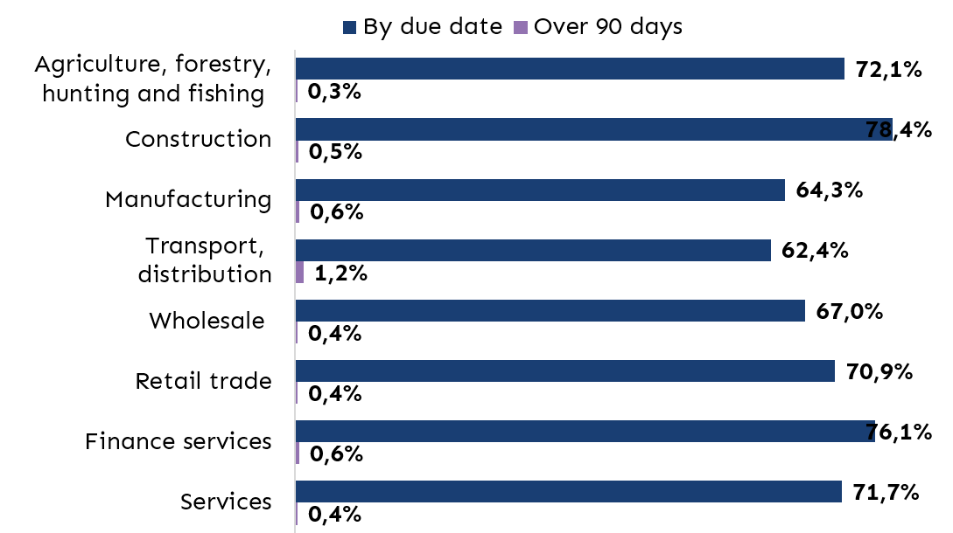
Italy is one of Hungary’s main trading partners. Exports include mechanical products, food and road vehicles. The imported products are chemical items, machinery, metal products, transportation and furniture.

Slide 14
In Rome there is the Hungarian Embassy, there are numerous consulates in other Italian cities, such as Naples, Milan, Turin and Florence. The Italian Embassy is located in Budapest and there are three consulates.
The Hungarians that live in Italy are 7.598;
The Italians that live in Hungary are 4.000.

Slide 15
Marco Rossi (born 9 September 1964 in Druento) is an Italian former footballer who played as a defender. He is currently the coach of the Hungarian National Team.

