Slide 1
Relations between Italy and Turkey
GIUSEPPE CAPUTO

Slide 2
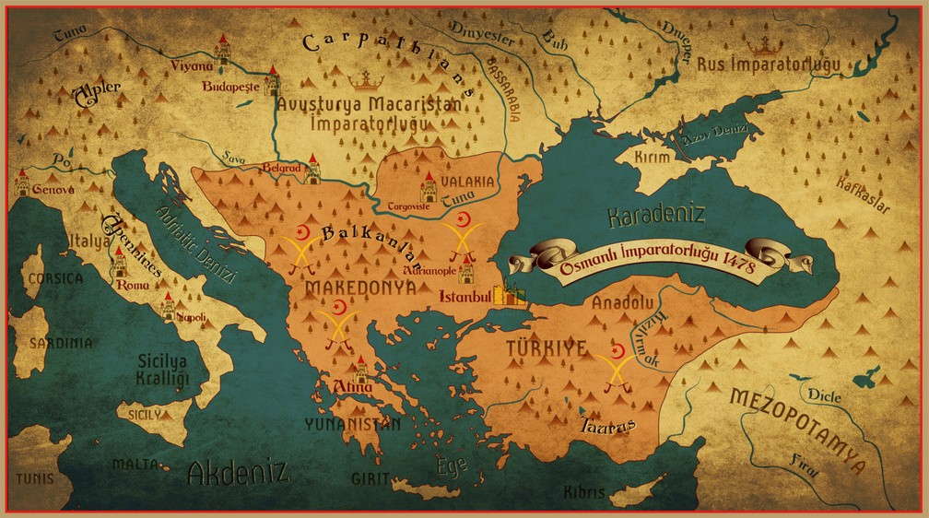
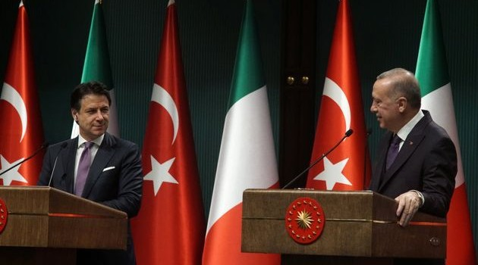
Today, Turkey and Italy are two regional powers that share common interests, history and values in the Mediterranean basin. It would be appropriate to define Turkish-Italian relations as a strategic partnership.
The two countries work together to find solutions to regional and global issues and also to bring peace and stability to a vast geographical area.
Turkish relations with Italy date back to the times of the Ottoman Empire, which had close relationships with Italian city states, such as Genoa and Venice. In fact, relations between the Ottoman Empire and Venice go back to 1381.
Diplomatic relations between Turkey and Italy were established in 1856 (in 2006, the 150th anniversary of diplomatic relations was celebrated).

Slide 3
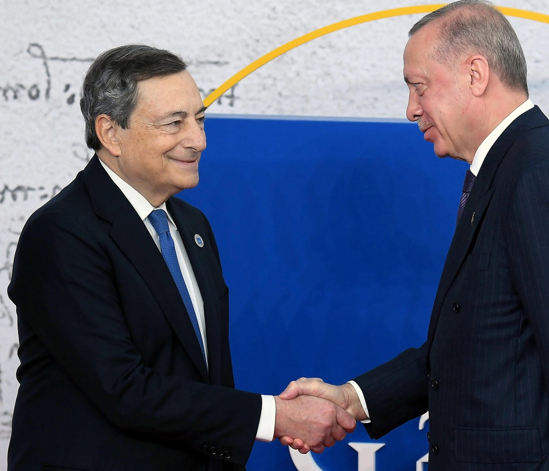
Turkish-Italian Forum and media forum
There are three important platforms to exchange views regarding Turkish- Italian relations: Turkey-Italy Intergovernmental Summits, Turkish-Italian Forum, and Turkish-Italian Media Forum.
These platforms strengthen the bilateral relations.
Turkish-Italian trade increased to $ 21.3 billion in 2011. The number of Italian firms operating in Turkey exceeded 900. They are engaged in various sectors, such as transportation, banking, telecommunication, construction, electronics and pharmaceuticals. Currently 44 Turkish companies operate in Italy.
Draghi and Erdogan

Slide 4
Tourism
Italy is perceived by Turkish tourists as a place of culture.
Turkish tourists expect to see the artistic beauty of the country, to experience the Italian lifestyle, to get to know local flavours.
The favourite Italian destinations remain Rome, Venice,
Florence, Bologna and Milan, with increased interest in
less known destinations such as Campania, Puglia, Liguria and Sicily.

