Slide 1
Relations between Italy and Lithuania
GIUSEPPE CAPUTO

Slide 2
Although Lithuania and Italy are in different parts of Europe, the first cultural ties between these countries can be traced back to ancient history and continue to this day. In 1518 Sigismund II Augustus, the King of Poland and the Grand Duke of Lithuania, married Bona Sforza, the daughter of the Duke of Milan Gian Galeazzo Sforza. Following this marriage, the Grand Duchess of Lithuania invited a large number of Italian men of culture and art to Vilnius, where they helped make the city one of the most beautiful capitals of the European Renaissance.
In 1570 the Jesuits founded the college of Vilnius, which in 1579 became a University, approved with the decrees of Pope Gregory XIII and the ruler Steponas Batoras. Many young Italians came here to study while Lithuanian students satisfied their thirst for knowledge in the universities of Bologna, Padova, Siena and Rome. Student exchange continued well into the sixteenth and seventeenth centuries.

Slide 3
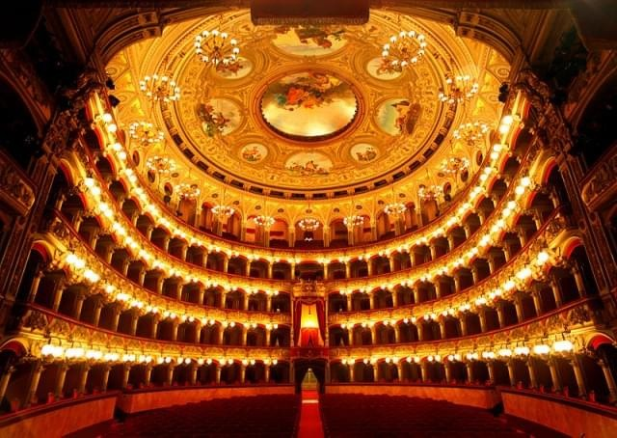
Music and Theatre
Furthermore, a beautiful tradition connects the musicians and artists of the two countries. Italy has always attracted Lithuanian singers. Lithuanian artists such as Kipras Petrauskas, Antanas Sodeika, Irena Milkevičiūtė, Vaclovas Daunoras perfected their talent in Italy, while today's opera singer Violeta Urmana has achieved great success among Italian audience and performs in the most famous theatres of Italy.In Italy the tradition of Lithuanian theatre is very well known. For years now, the Italian public has followed the works of the master Eimuntas Nekrošius, today one of the most famous directors in Italy and in the world, with great interest and passion. Theatre enthusiasts also appreciate another great Lithuanian director Oskaras Koršunovas.
Bellini Theatre Catania

Slide 4
Literature
In Lithuania, on the other hand, Italian literature is widespread and admired. More than one hundred Italian authors have been translated from Italian into Lithuanian since the beginning of the 20th century. Furthermore, the interest in the Italian language and culture is growing: every year the number of students who choose Italian studies in Lithuanian universities or enroll in Italian language courses increases.

