Slide 1
SLEEPING BEAUTY

Slide 2
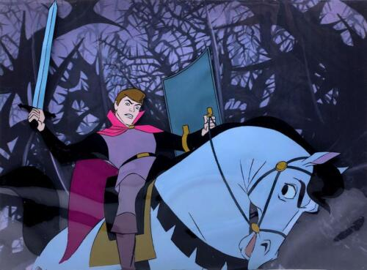
„The wood turned out to be too thick; so that the prince could not handle it. In addition, he discovered a free Wi-Fi connection with excellent strength nearby and thought he would check Wikipedia to see what the thick wood could hide. However, he was so engrossed in surfing that the curse stuck to him and he fell into a deep sleep. Centuries had passed. No one remembered what could be behind the thick wood. Environmentalists declared it as a protected area, so no one ventured near it.

Slide 3
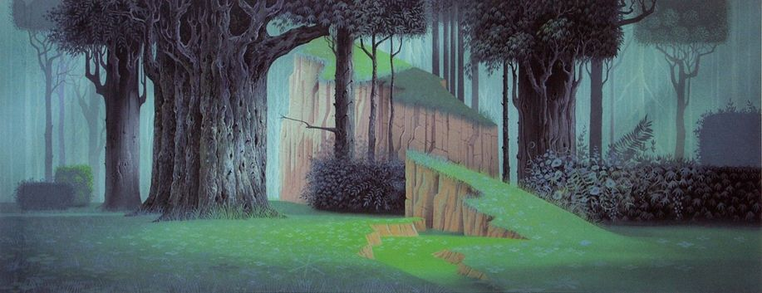
However, it happened that the participants of the Literacy for the future Erasmus + project decided to put down their mobile phones and spend their time with reading and going on trips and nature walks. They had also heard about the protected dense wood and thought that this was a great challenge for them. They made very difficult progress, but since they were determined and didn't have their mobile phones with them, they quickly found the old castle.

Slide 4
Passing through the cobwebbed halls, memories of horror movies flashed before them, but they overcame their fear and entered the last room. A beautiful girl was sleeping there. Her face was ruddy, even though she wasn't wearing any make-up because she was asleep. They were very surprised. Several people thought it was a zombie, but then seeing the sweet face of the sleeping girl, they dismissed it. While they were debating what to do everyone slowly started reading. They had brought a lot of books with them on the trip. They were so engrossed in reading that they didn't even notice when the princess opened her eyes.

Slide 5
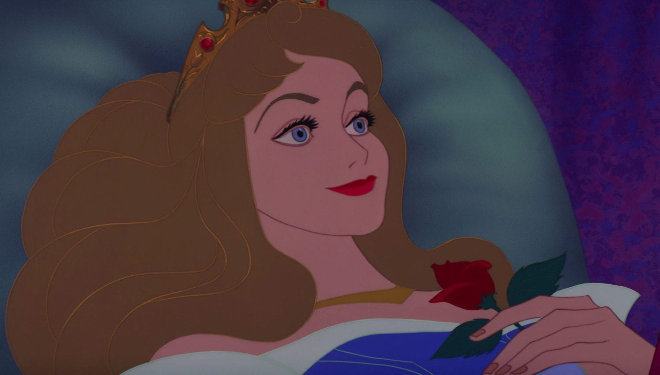
She looked around in shock. There were a lot of students around her. She also screamed softly, because the sight of the reading children was very scary. Everyone put the book down at that sound. The initial fear quickly disappeared. Since the princess did not remember anything and did not seem dangerous; the project participants took her with them.

Slide 6
To cut my story short: the princess enrolled in the 9th grade of one of the schools participating in the project. The problem was that the sciences were definitely not for her, so she decided to take a job instead of studying, even though she didn't even have her final exams. She got a job as a weaver in a textile factory. Weaving and spinning brought her great joy. She thought he had finally found the meaning of her life.

Slide 7
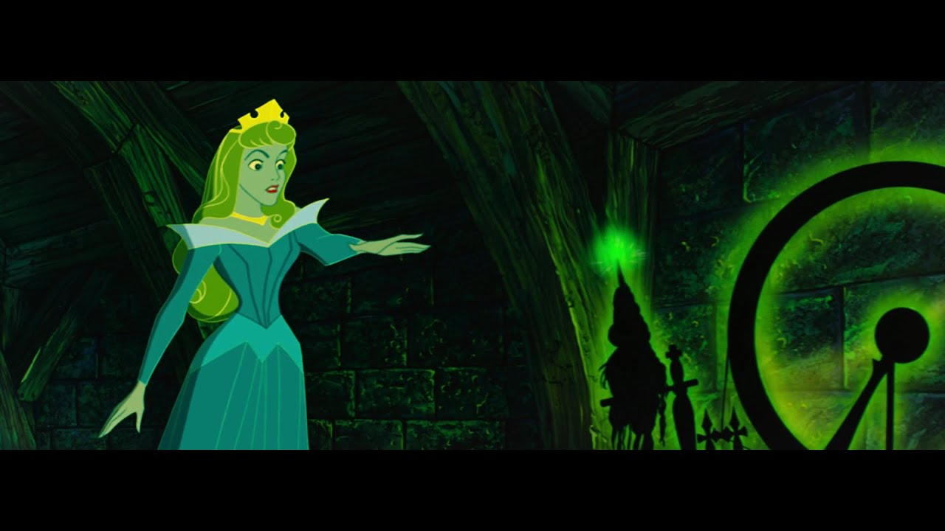
However, one day there was an industrial accident. The bobbin falling from the weaving machine pierced her hand, causing her to fall into a deep sleep. Everyone in and around the factory also fell asleep. No one moved for a long, long time. A thick hedge of wild roses sprouted all around, grew taller year by year, wrapped itself around the factory and finally ran into the factory so that nothing could be seen anymore, not even the factory’s chimney. So what happened next?

Slide 8
We will have to wait for the answer until the next Erasmus project.”

Slide 9
Thank you for your attention!

