Slide 1
Rosie Walsh: THE MAN WHO DIDN'T CALL
My favourite literary work

Slide 2
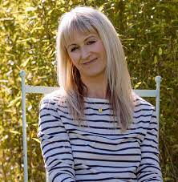
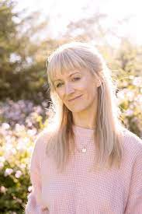
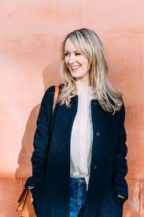
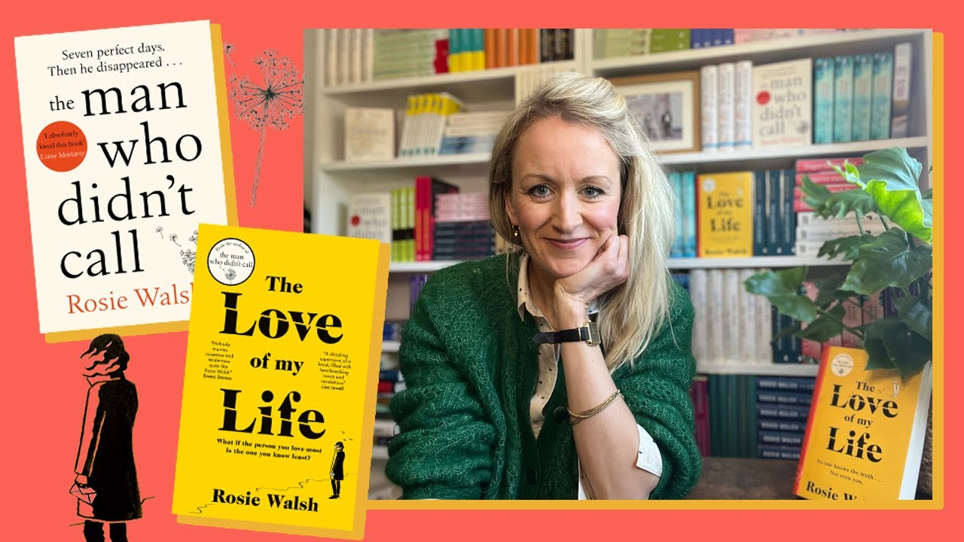
About Rosie Walsh
Rosie Walsh has lived and travelled all over the world, working as a documentary producer and writer.
She was born in March on 18, in 1980
She worked in TV and theatre after graduating college
Rosie came to writing (after a career in factual television,) which took her to some of the remotest places on earth.
Her husband is George
They now live in Devon, UK, with their two young children.

Slide 3
About Rosie Walsh
Rosie Walsh is the author of the international bestseller, THE MAN WHO DIDN'T CALL
Lucy Robinson: The Greatest Love Story of All Time, The Day We Disappeared, and A Passionate Love Affair With a Total Stranger.
Her next novel, THE LOVE OF MY LIFE
She announced that her book The Man Who Didn't Call would be published in 2017 and would be the first one published under her own name.

Slide 4
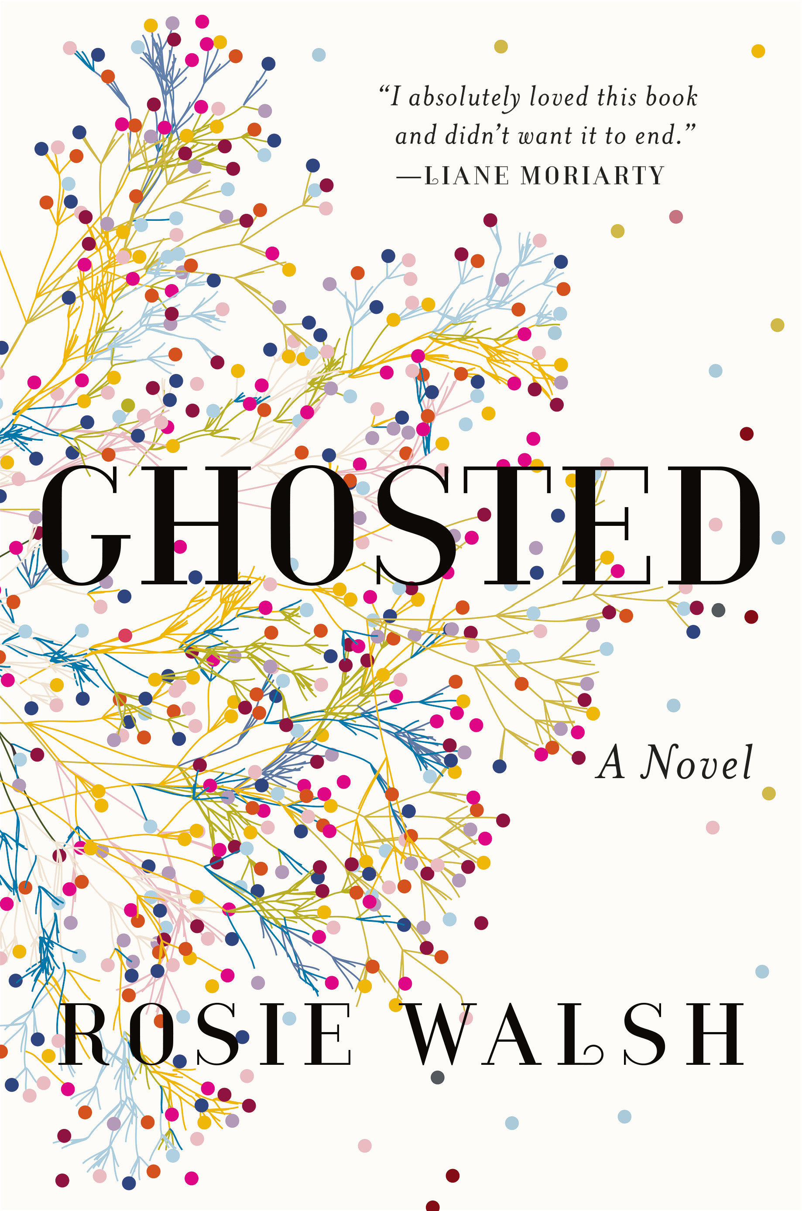
The man who didn’t call
The Man Who Didn’t Call (UK) / Ghosted (US) is her first book under her own name, and was published around the world in 2018, going on to become an instant bestseller in several territories. It was a New York Times top five bestseller and topped the charts in Germany for several weeks.
Six perfect days. Then he disappeared. A love story with a secret at its heart.
When Sarah meets Eddie, they connect instantly and fall in love. To Sarah, it seems as though her life has finally begun. And it's mutual: It's as though Eddie has been waiting for her, too. Sarah has never been so certain of anything. So when Eddie leaves for a long-booked vacation and promises to call from the airport, she has no cause to doubt him. But he doesn't call.
Sarah's friends tell her to forget about him, but she can't. She knows something's happened--there must be an explanation.
Minutes, days, weeks go by as Sarah becomes increasingly worried. But then she discovers she's right. There is a reason for Eddie's disappearance, and it's the one thing they didn't share with each other: the truth.
Genres: Fiction, Romance, Mystery, Contemporary

Slide 5
Thank you for watching! ☺
Made by: Bianka Püspöki
https://moly.hu/konyvek/rosie-walsh-ghosted
https://www.amazon.com/stores/Rosie-Walsh/author/B07BVXSCNJ?ref=ap_rdr&store_ref=ap_rdr&isDramIntegrated=true&shoppingPortalEnabled=true

