Slide 1
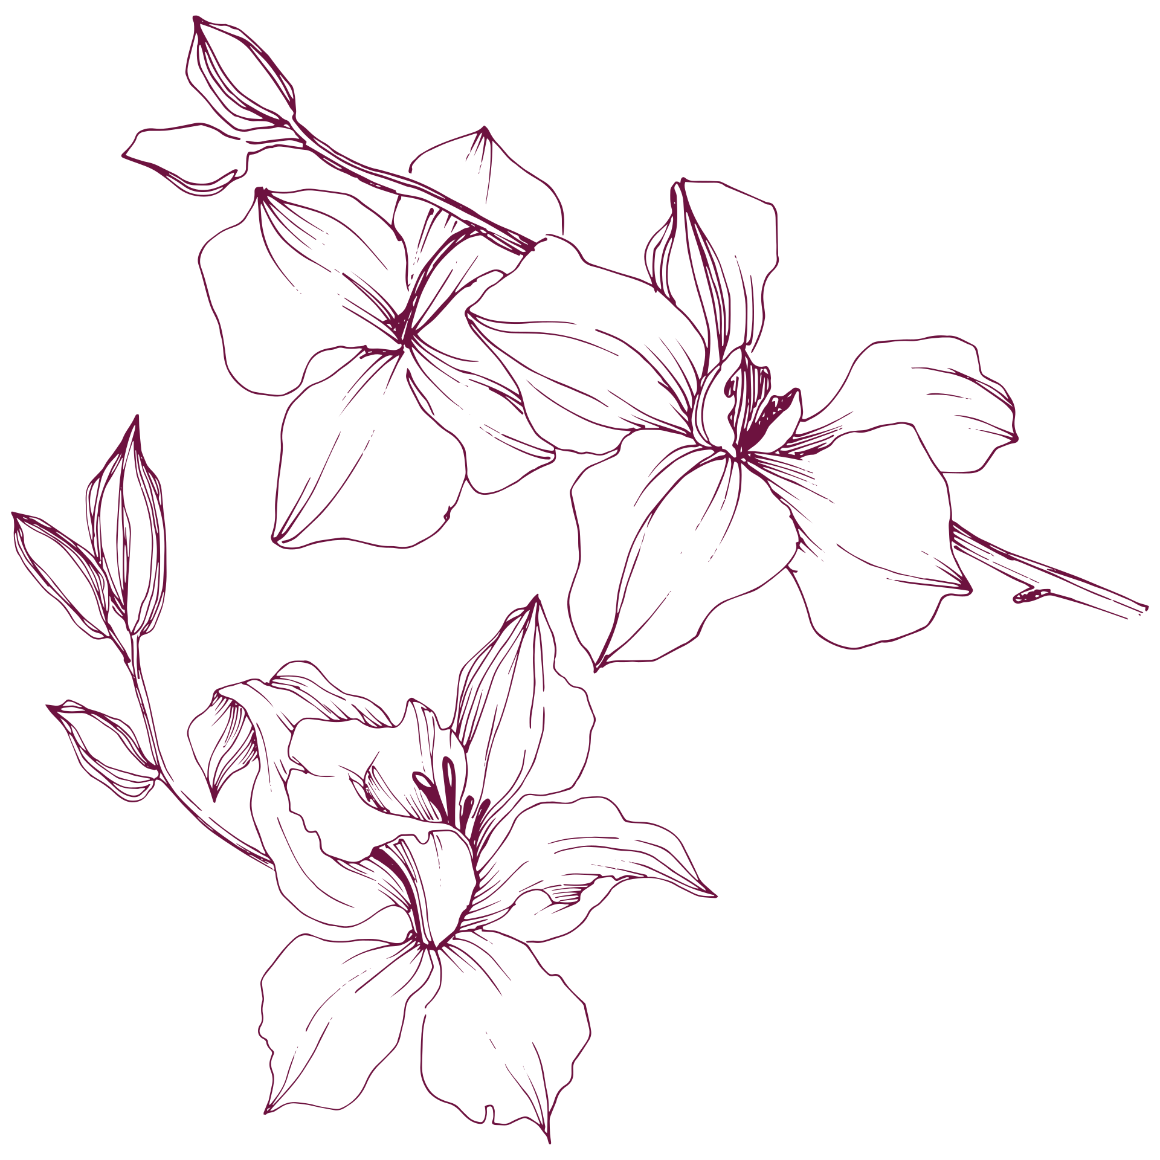
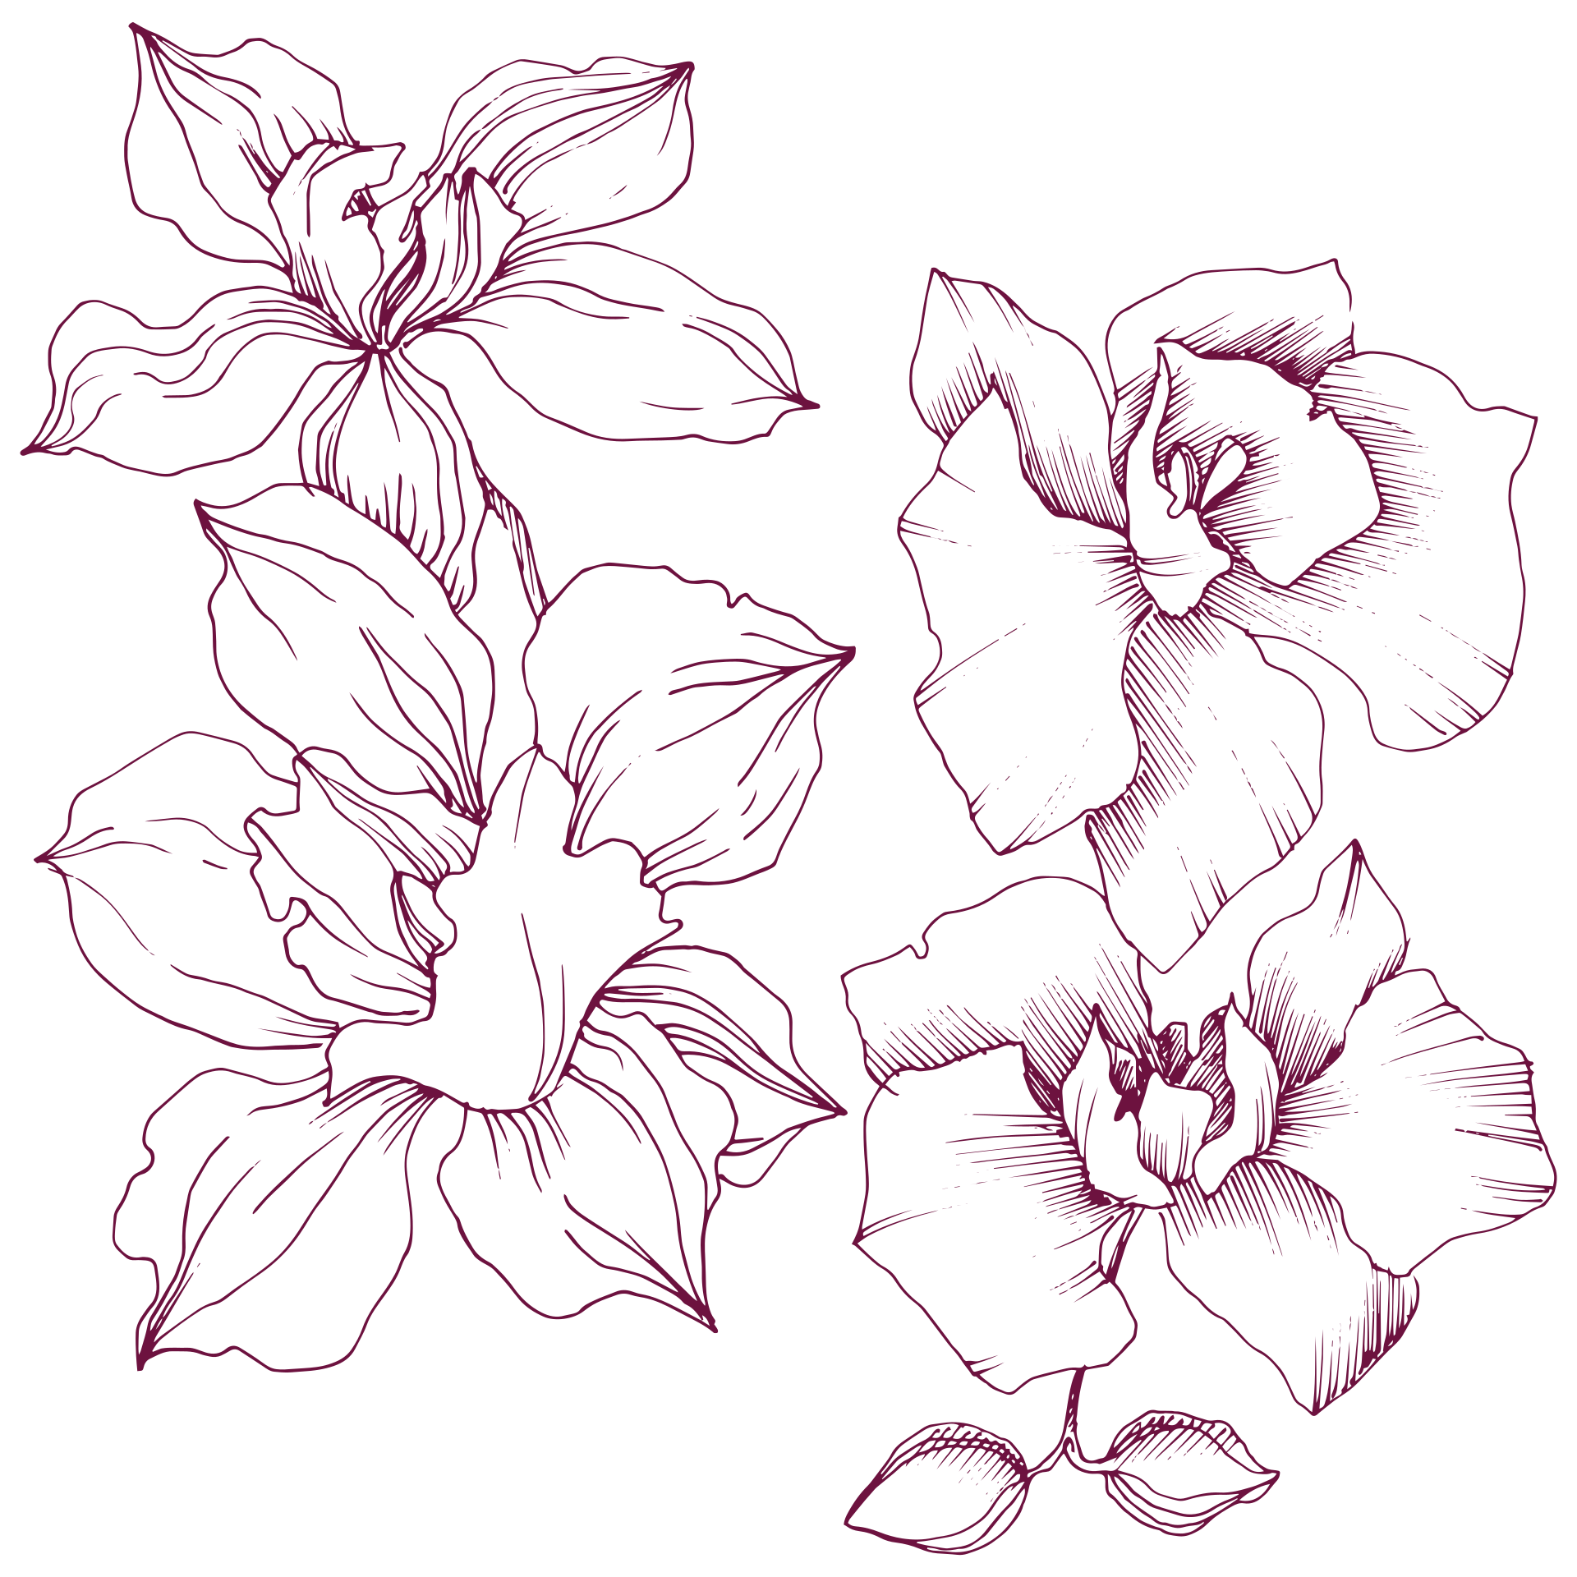
Rading Week 4- Poland
Literacy competition for teenage writers

Slide 2


The aim of the competiton
Teenagers were to create writings in following categories:
  article
  scriptwright
  story

Slide 3
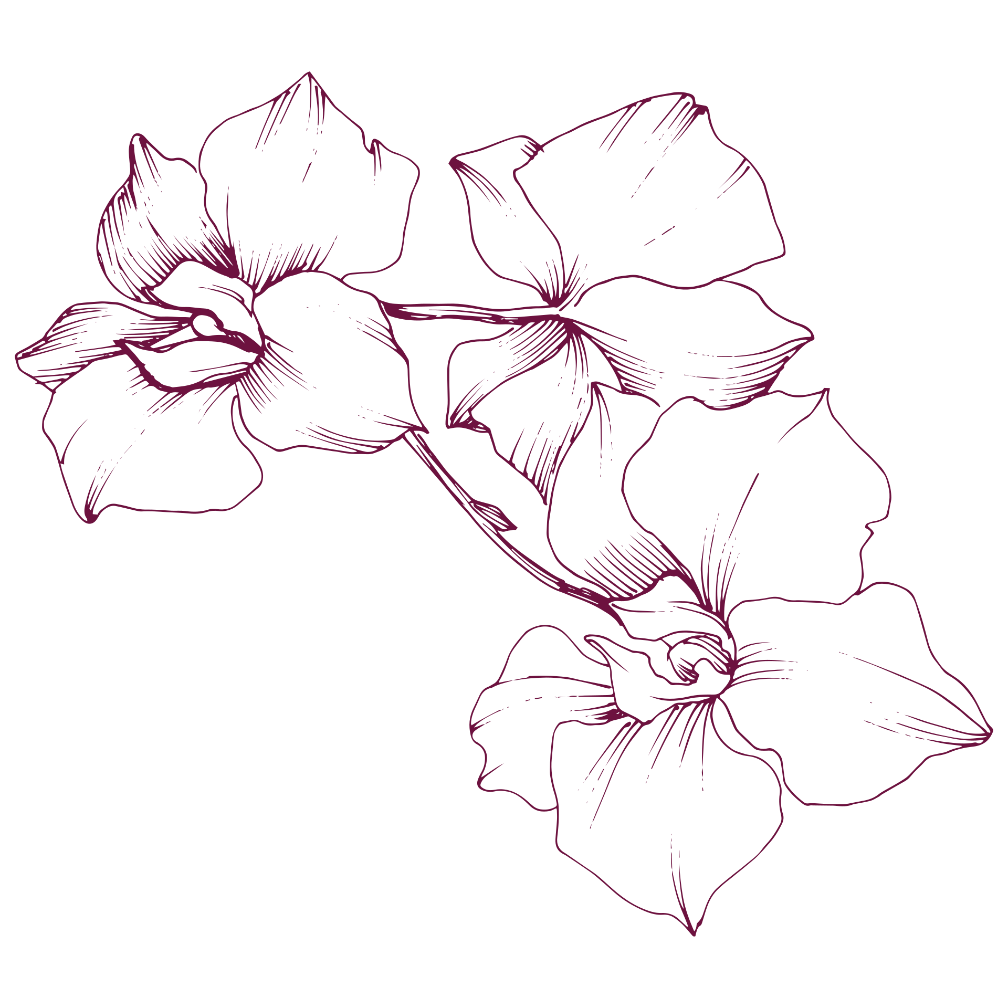
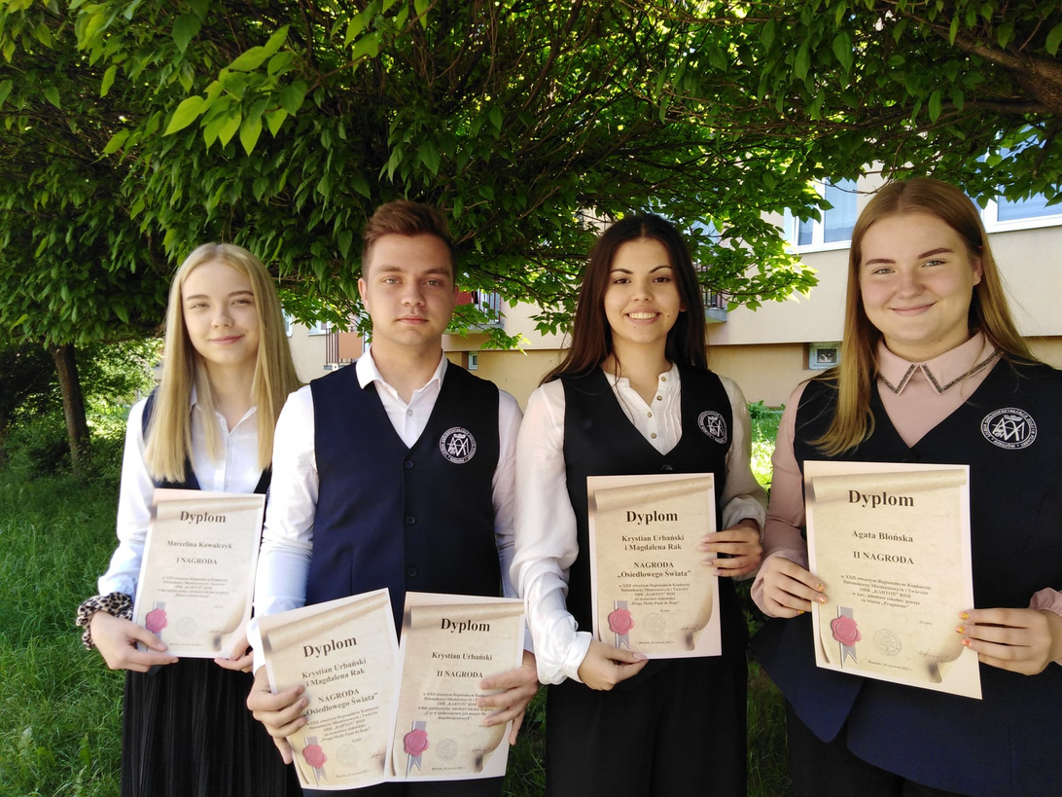
Four students from Piarist High School in Rzeszow, Poland were awarded for the best story, scripwright and an article.

Slide 4

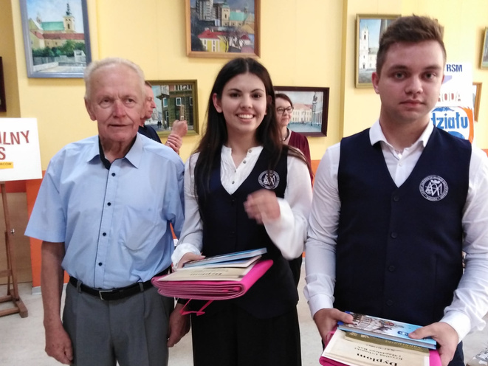
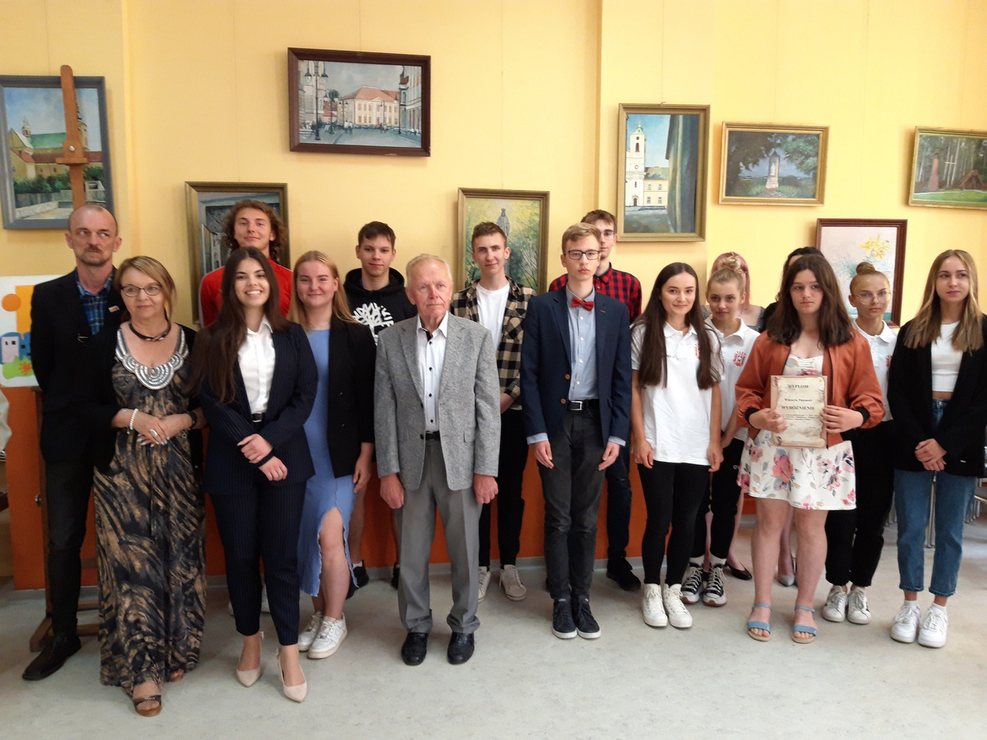
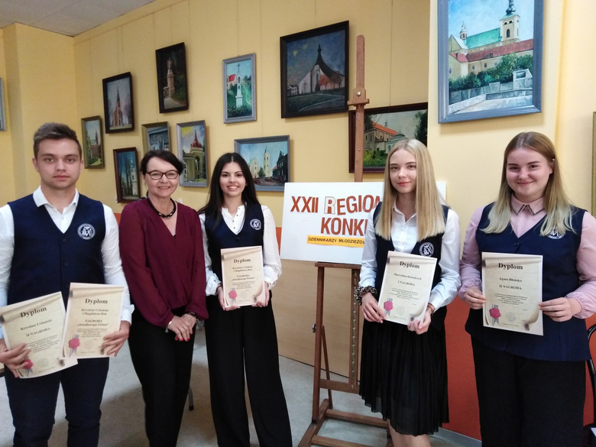
Photo gallery

