Slide 1
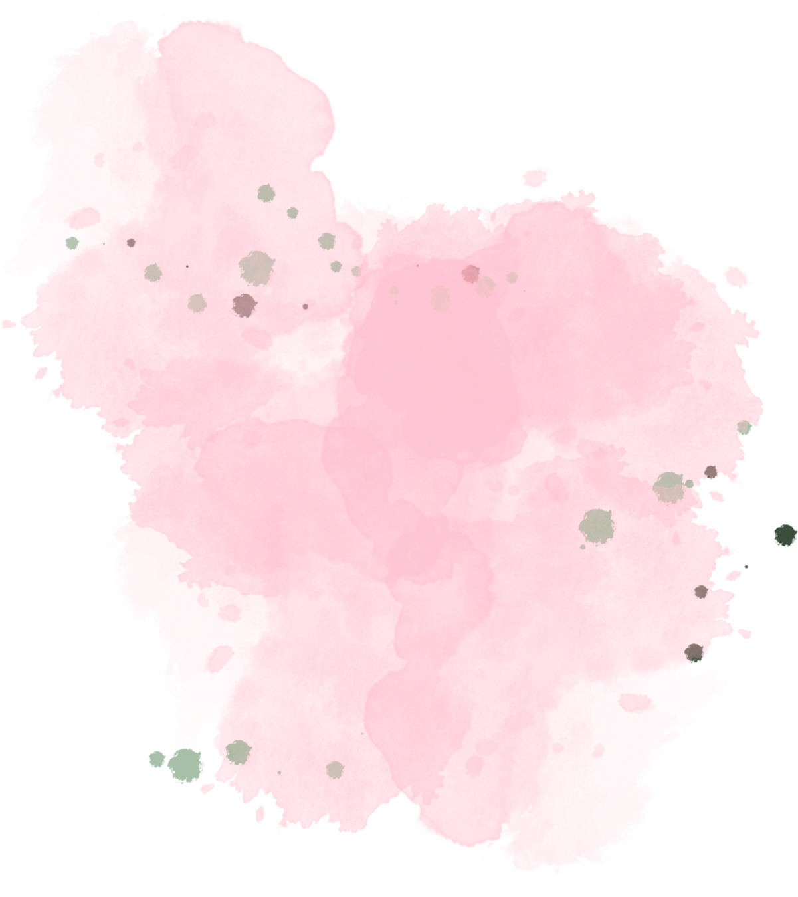
Reading Week
3rd Edition
Piarist High school in Rzeszow, poland

Slide 2
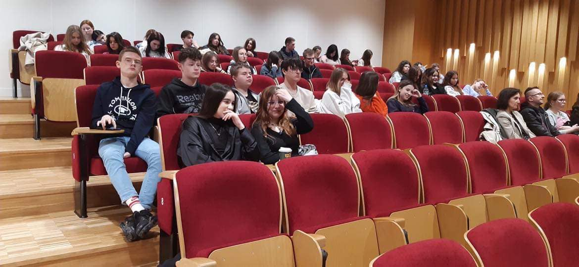
Reading Week
March 27th-31st
This time our reading week consisted of several acitivites. first of all we visited the Univeristy of Rzeszow to listen to a lecture about literature.

Slide 3
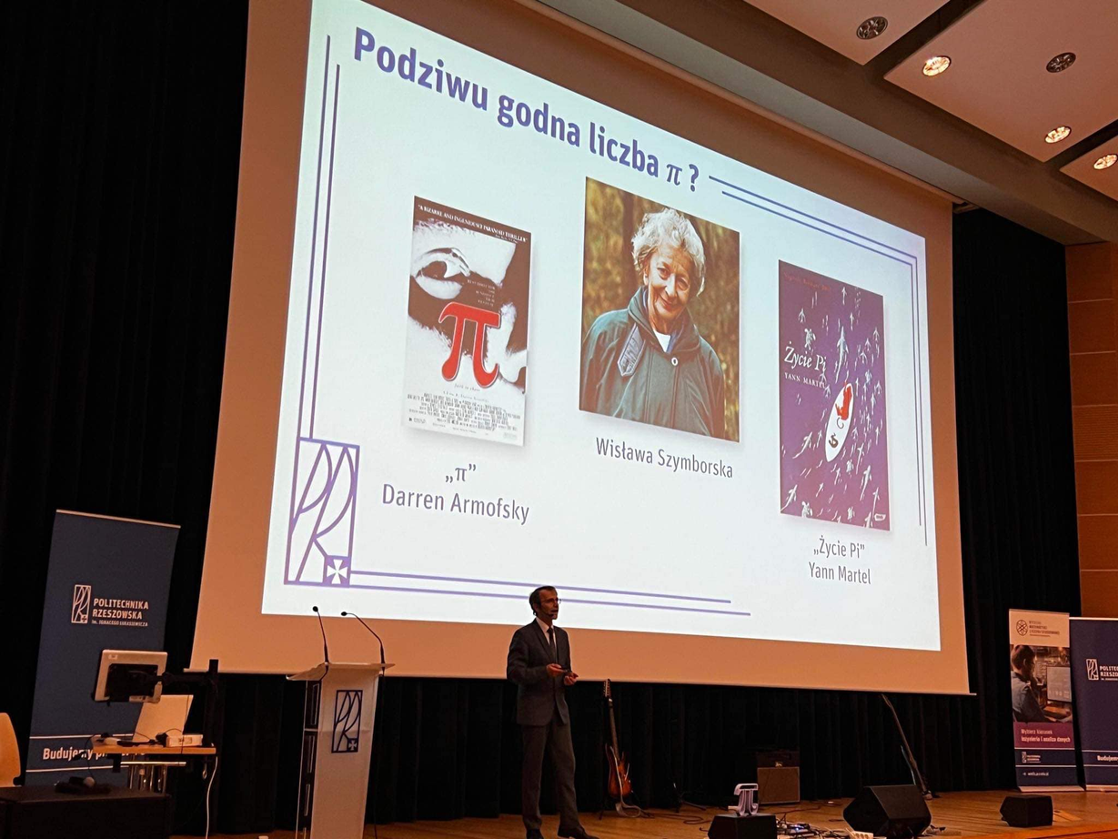
Lecture about famous Polish poet
During the lecture which treated about Wisława Szyborska's poems we got to know the importance of literary figures.
Wisława Szymborska was the first Polish female poet who got the Nobel prize in literature.

Slide 4
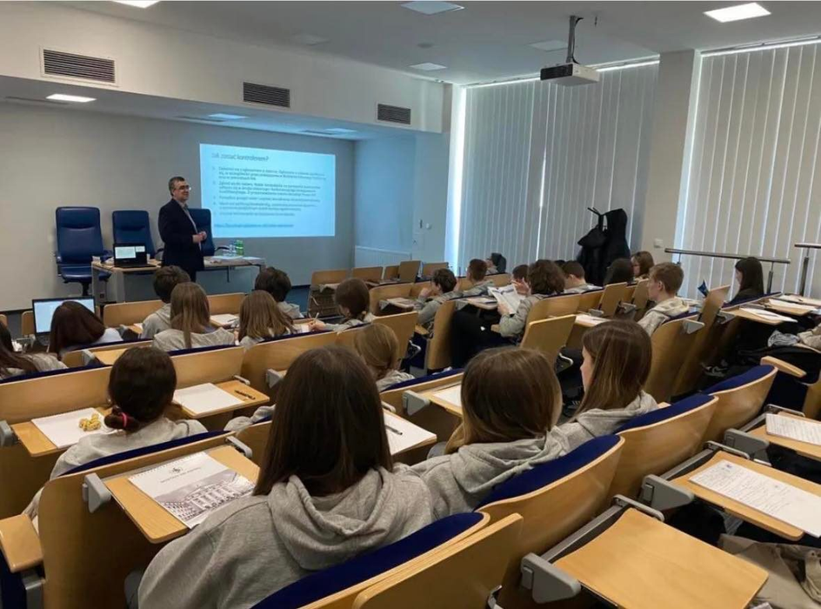
Literature Classes
As another part of the 3rd Reading Week we took part in literature classes at Rzeszów University.
This time we not only listened to the lecturer but also we could also try to create our own literacy pieces.

Slide 5
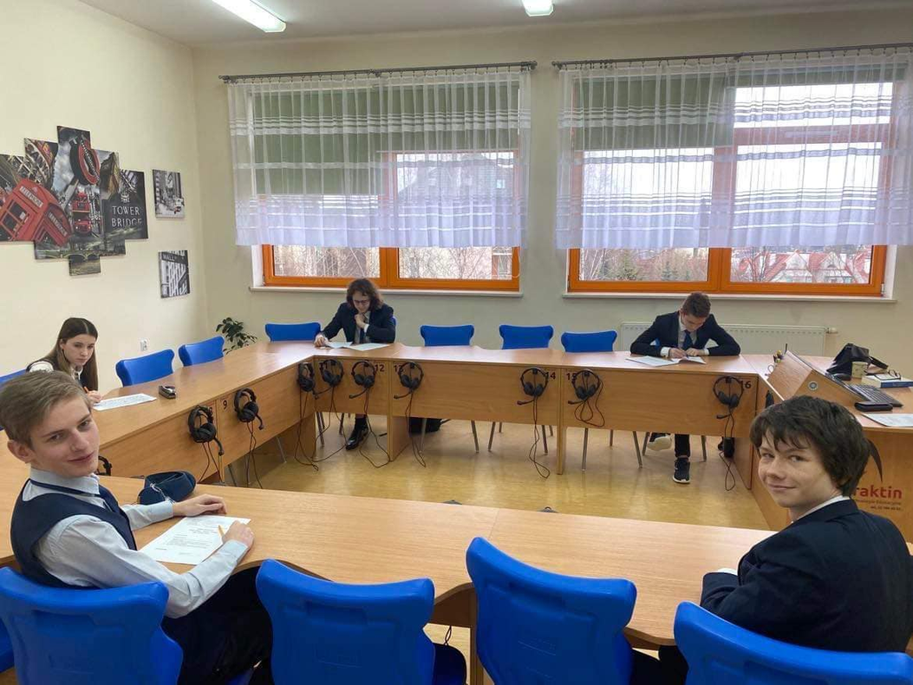
Competition
The final part of the Reading Week was a written competition on Wisława Szymborska's life and poetry.

