Slide 1
Reading Week
In Piarist High School in Rzeszow, Poland

Slide 2
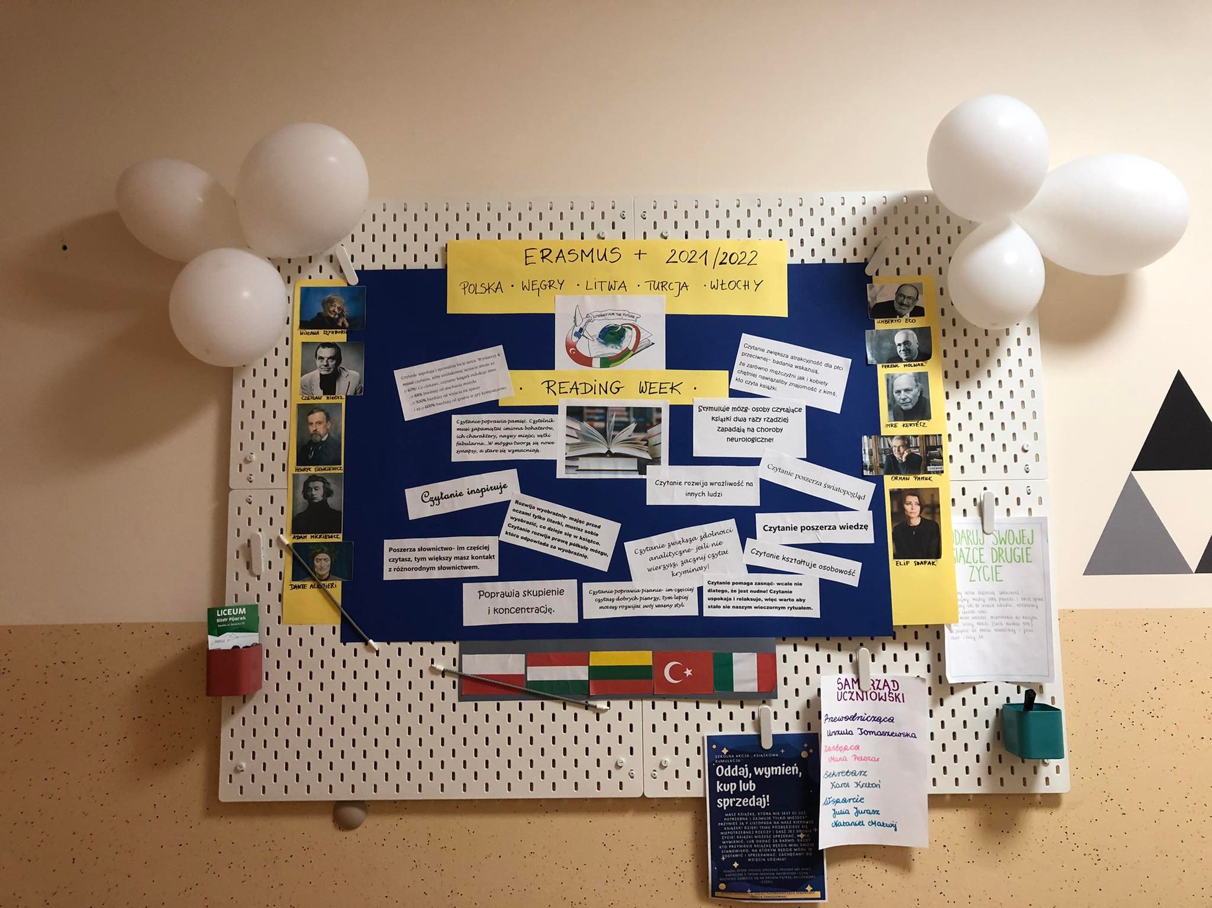
What we have done:
We prepared a poster about the advantages of reading books

Slide 3
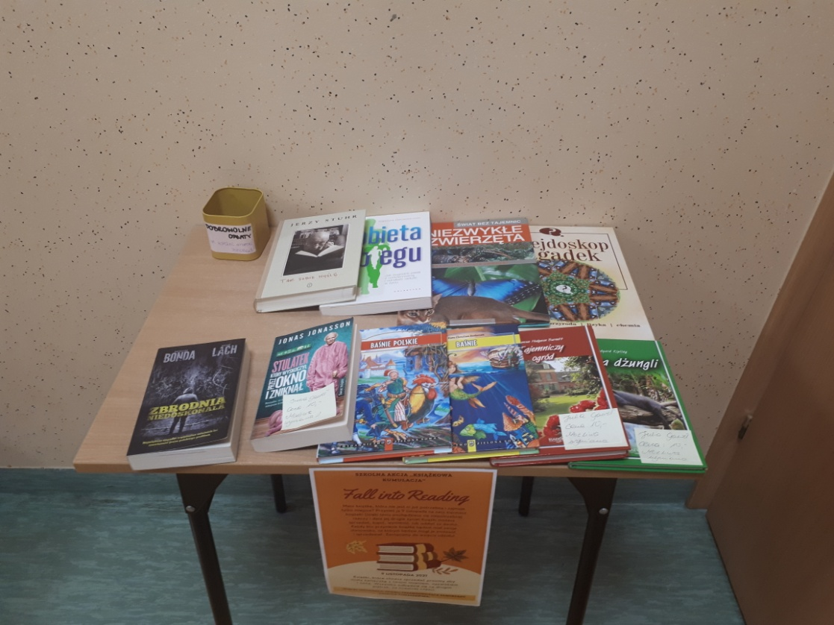
What we have done:
On our school corridor we organized a book swap place where students can leave novels they have already read and exchange them for the new ones.

Slide 4
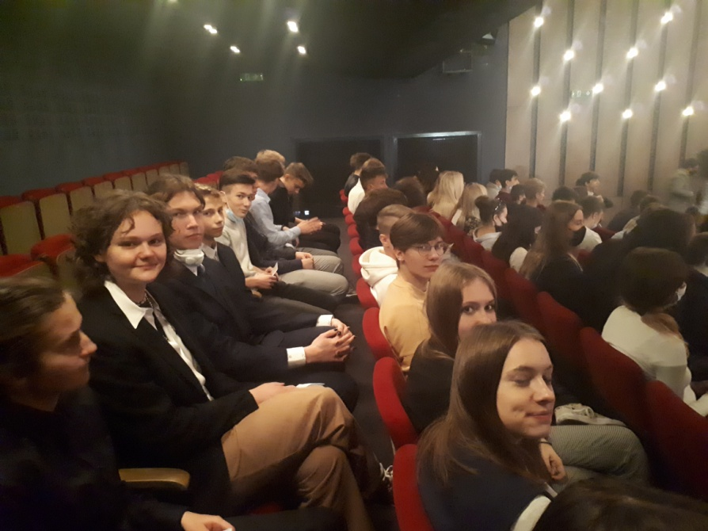
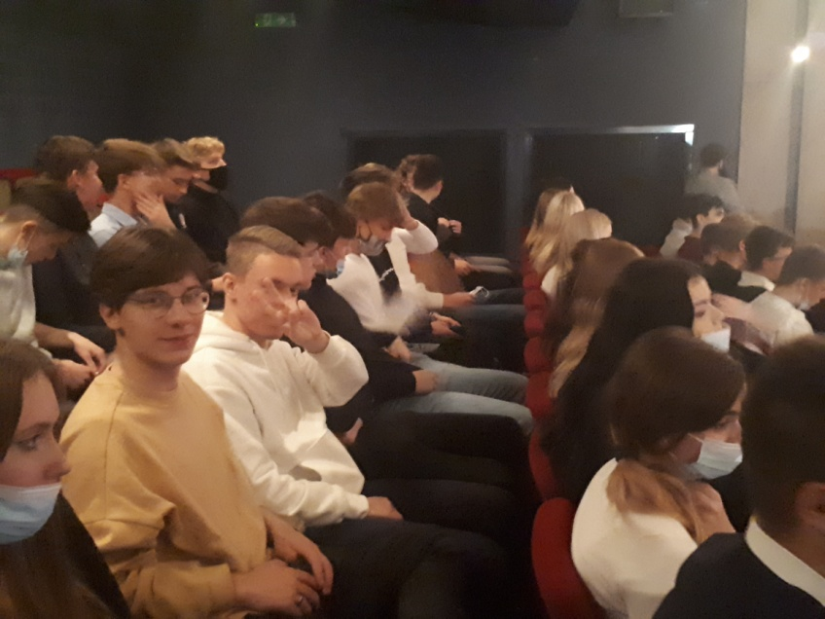
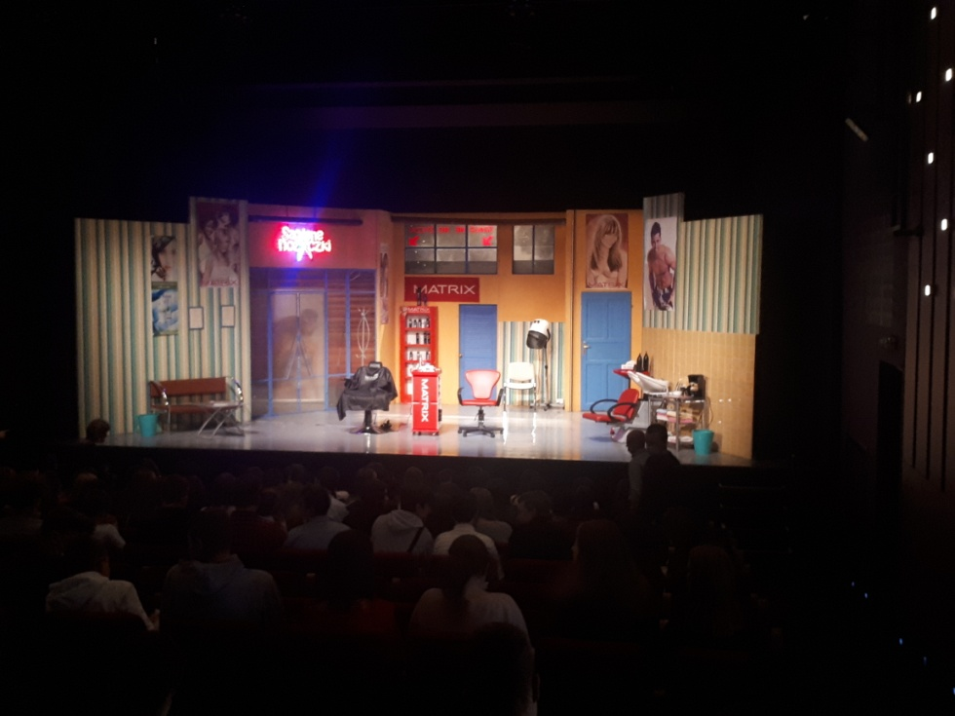
What we have done:
We visited the theatre to watch a comedy play.

Slide 5
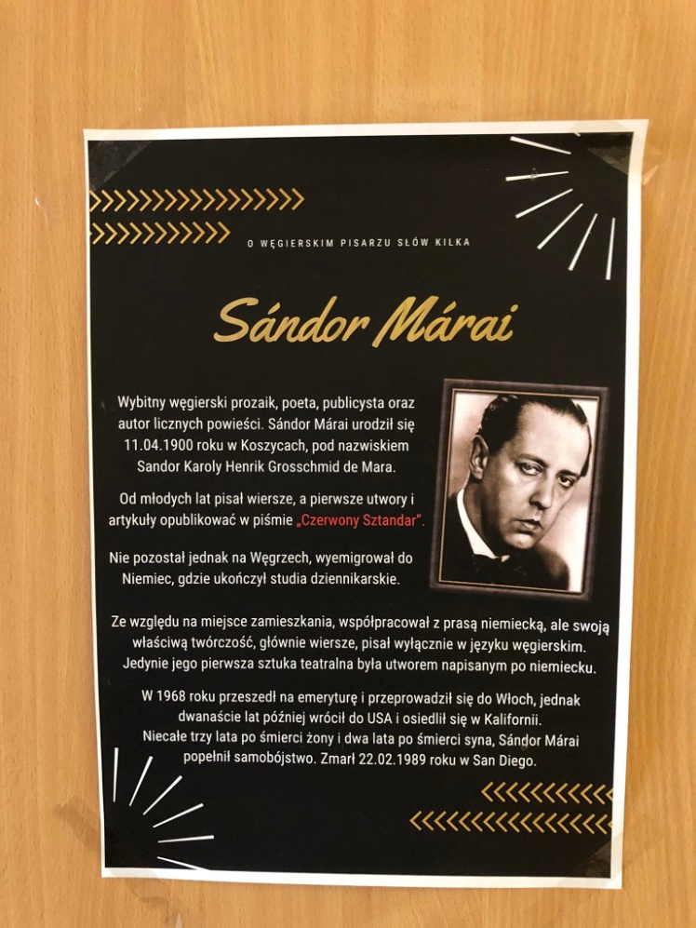
What we have done:
We decorated the doors of the classrooms with some short biographies of famous writers from our Erasmus countries.

Slide 6
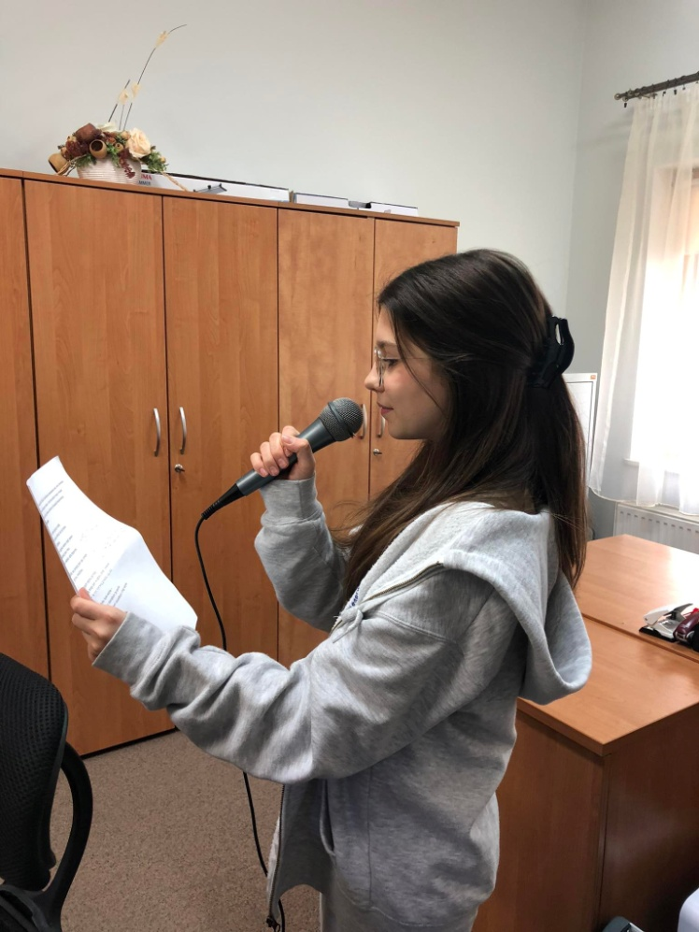
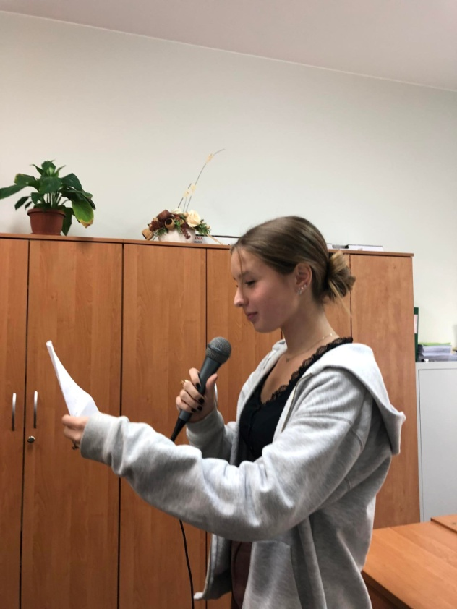
What we have done
Every day we read one poem (via school radio) by one author from our Erasmus country.

Slide 7
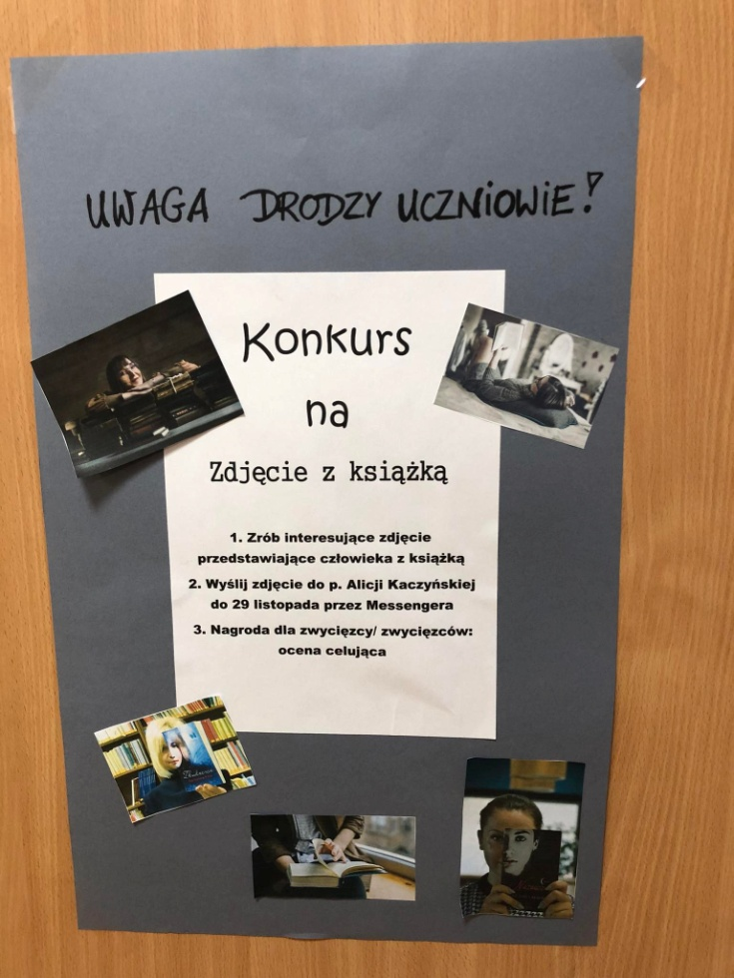
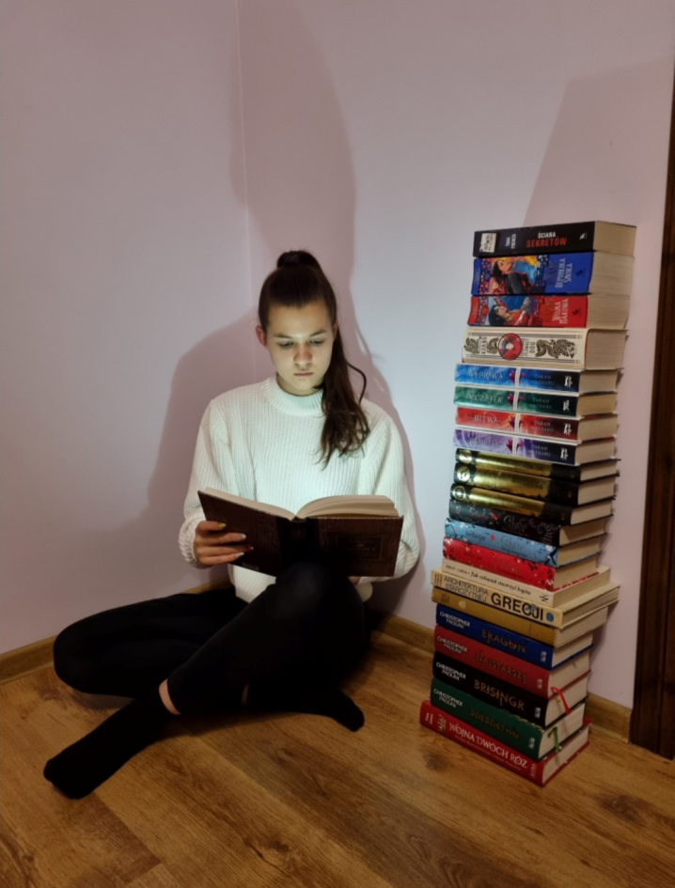
What we have done
We ‘ve organized a contest for the best picture with a book.

